Slide 1

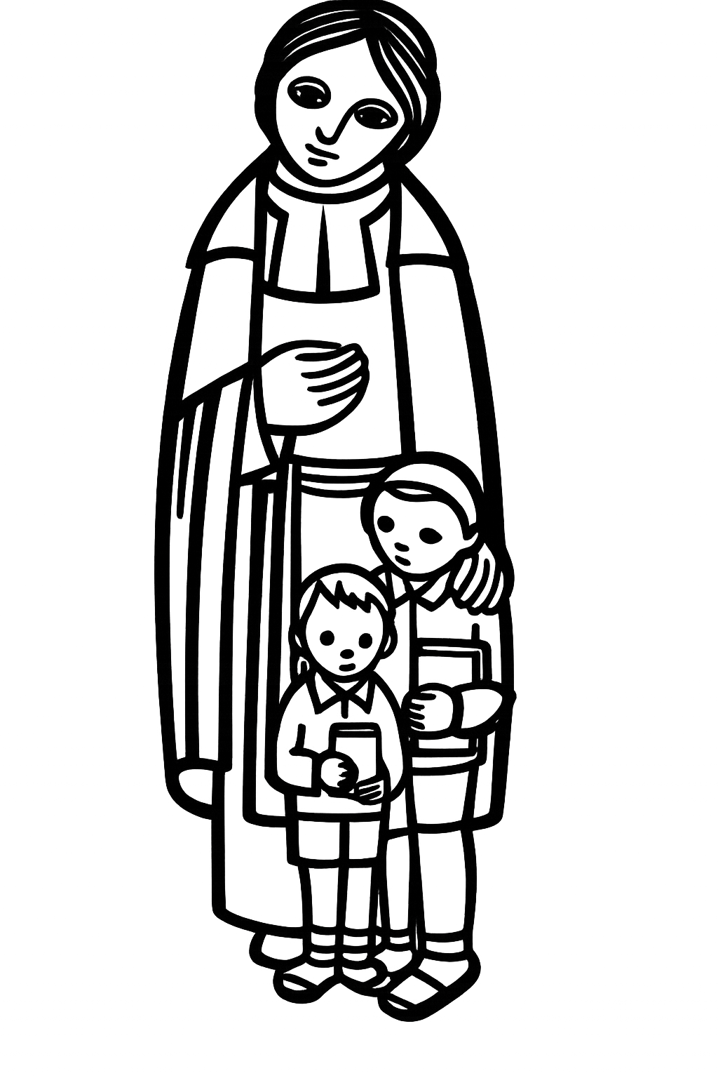
May God continue
what he has begin in you.
-Letter 46- to Brother Robert in Darnetal, 1709:
4. Lasallian Mission Today

Slide 2
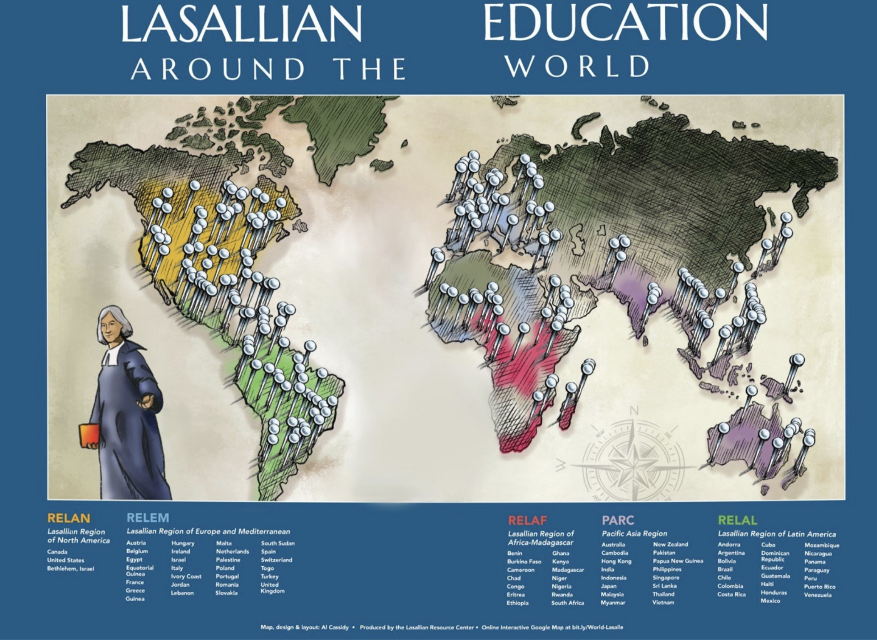
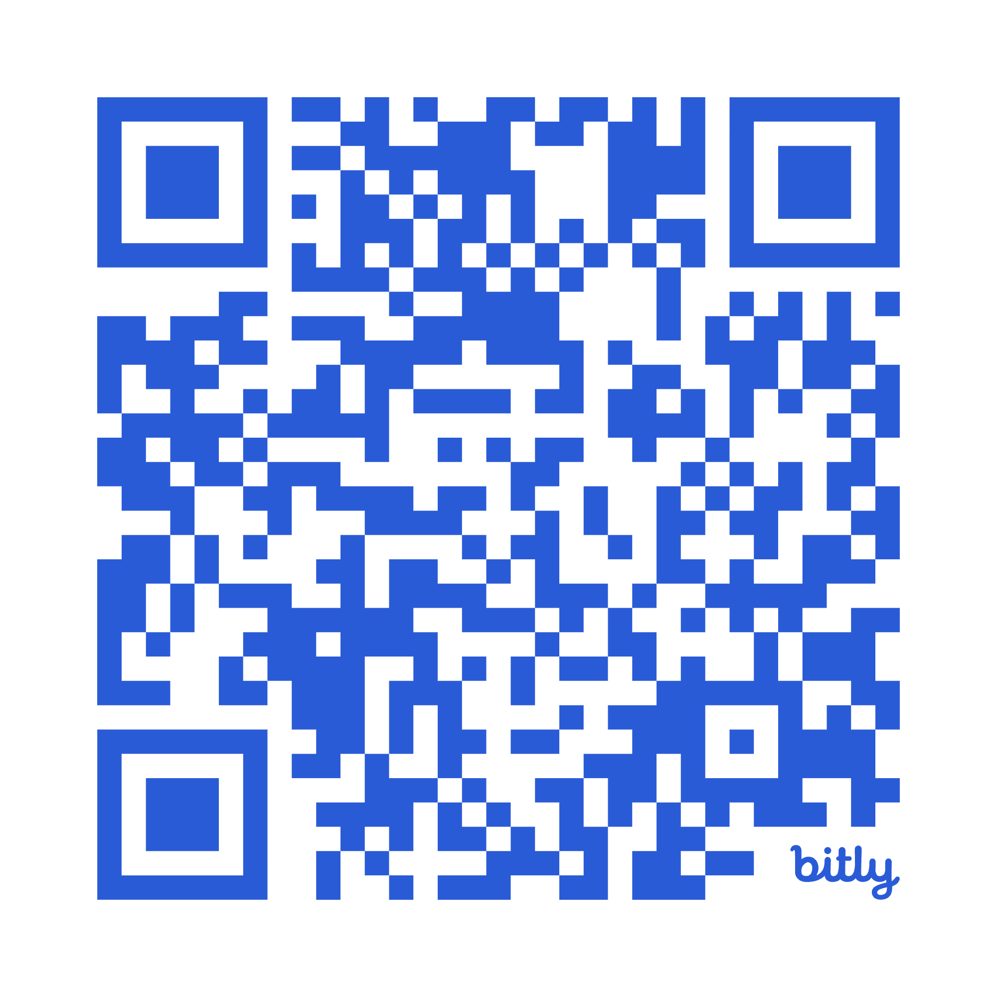
Notes:
In the last two sections, we talked about how important community is to the brothers, both in the beginning as well as helping them live their vocation. What do you believe will help them keep that community feel while they are spread around the world?
URL links to Lasallian Ministries Today, an interactive map of Lasallian ministries and tell you more about the school. Most schools have web sites.
In addition, the website https://lasallian.info/what-we-do/twinning/ gives more information about twinning and twinning schools

Slide 3
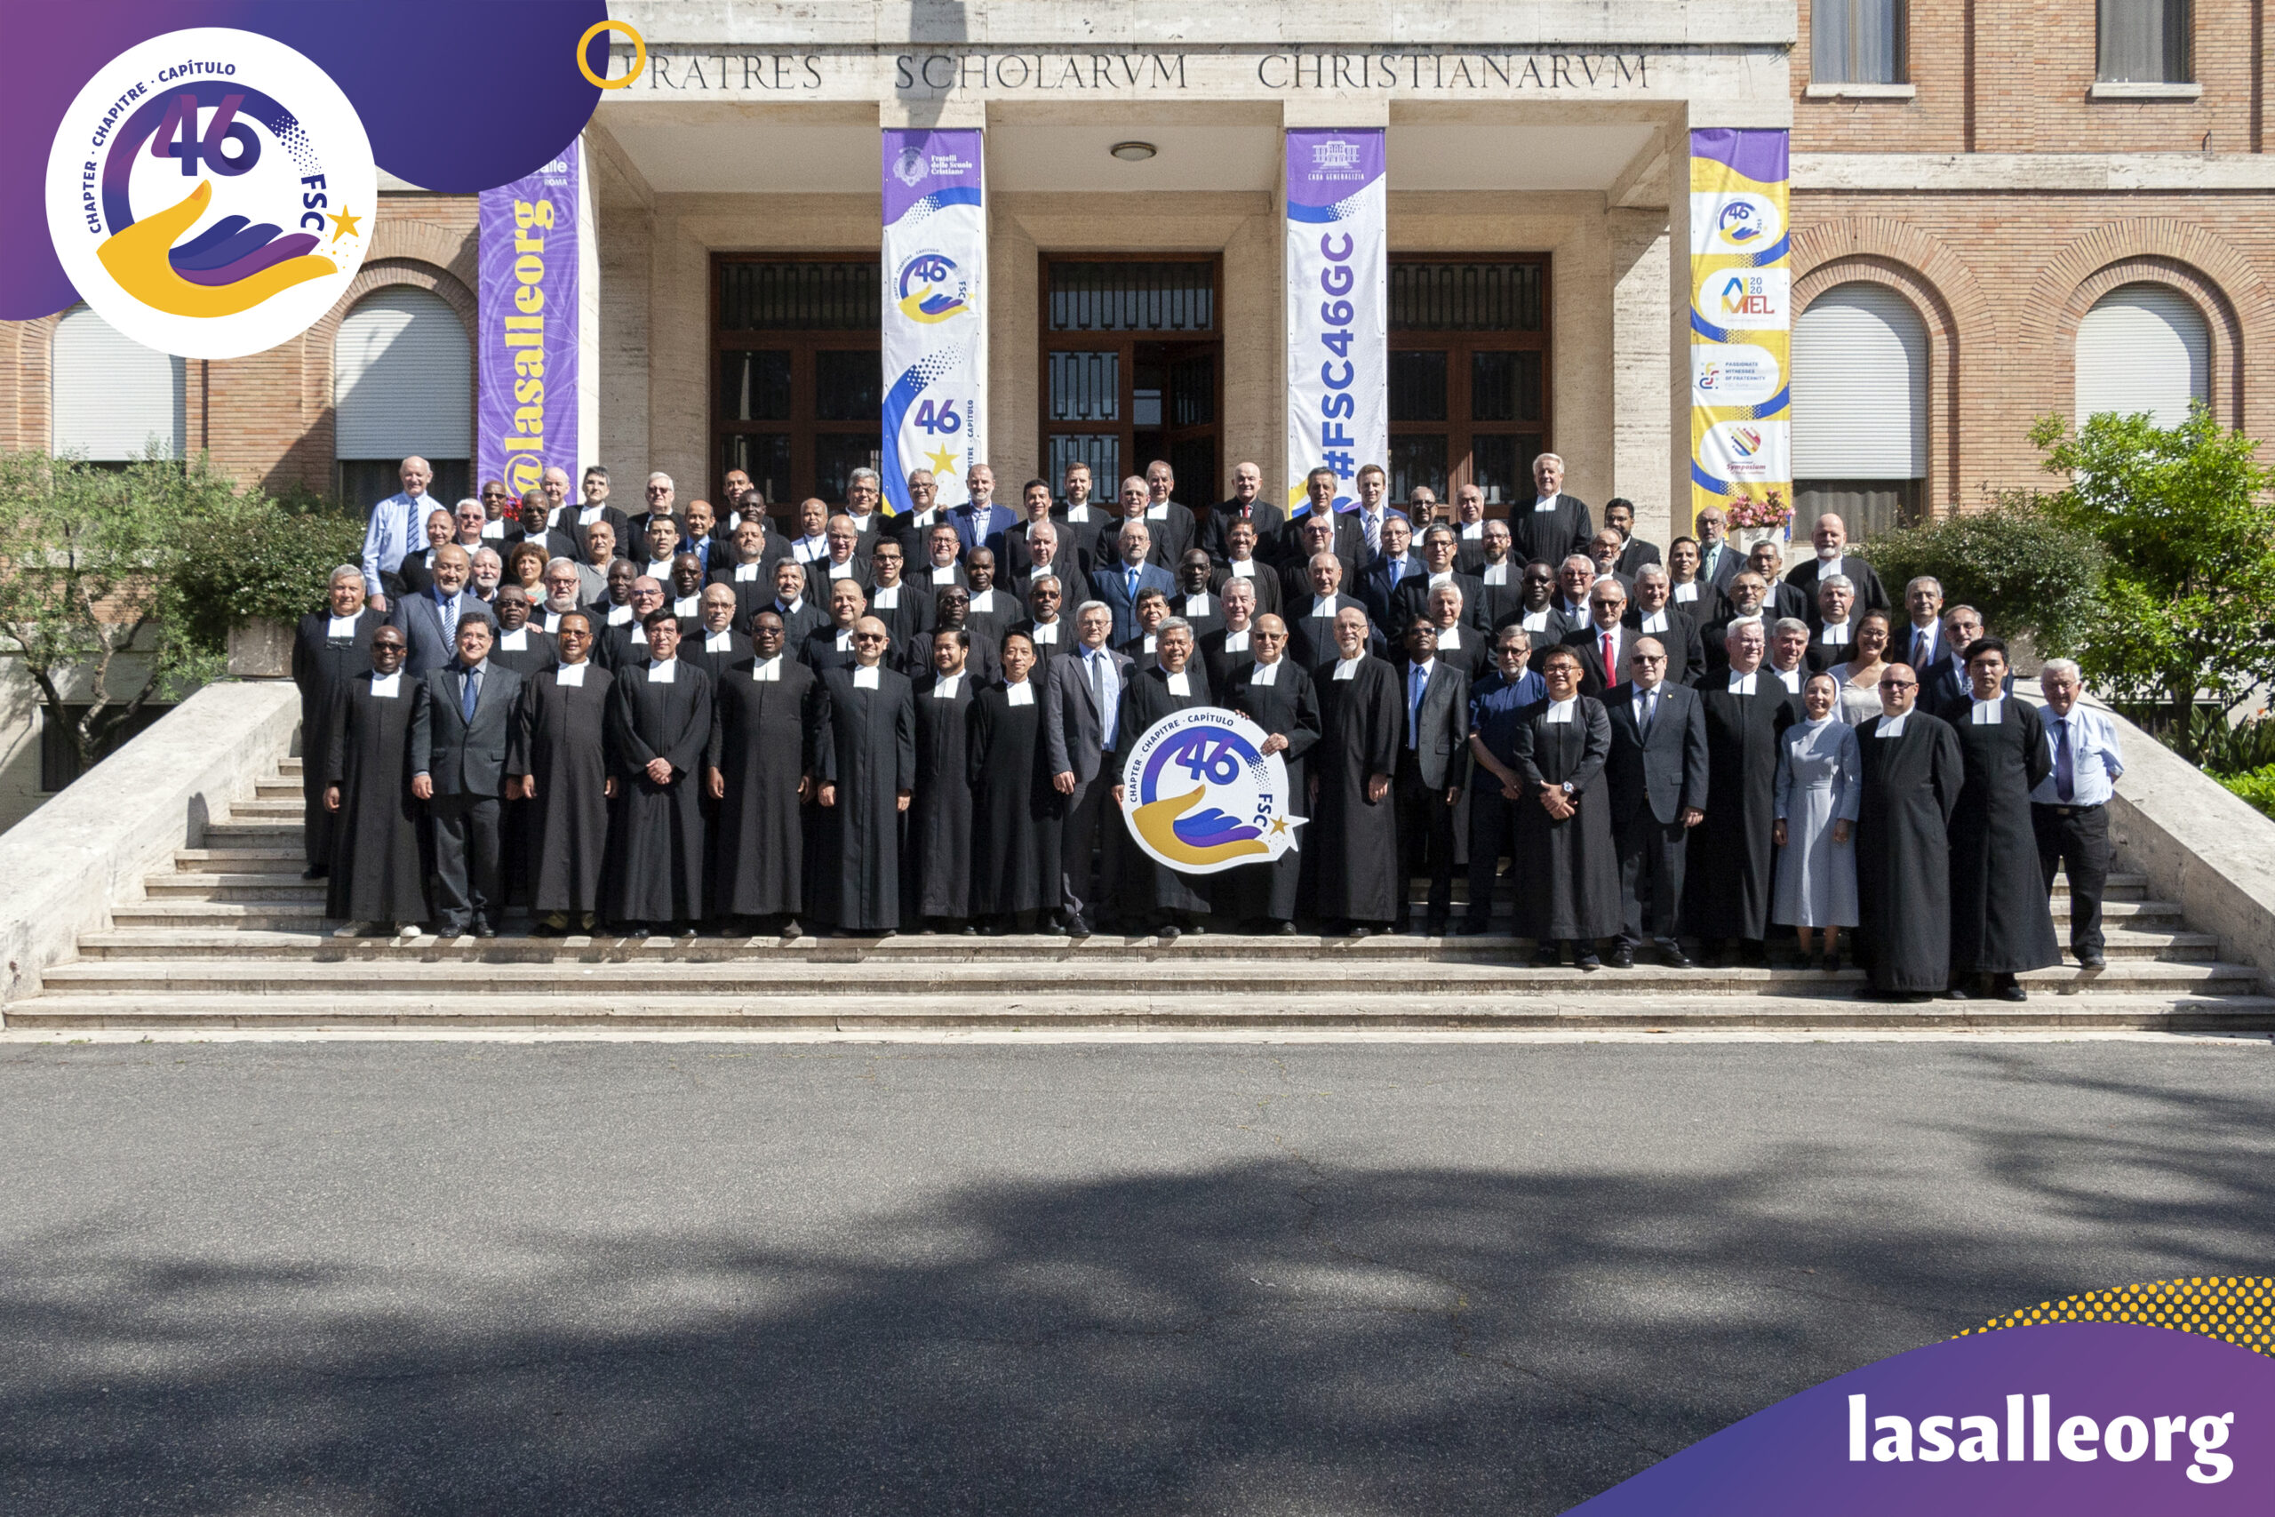
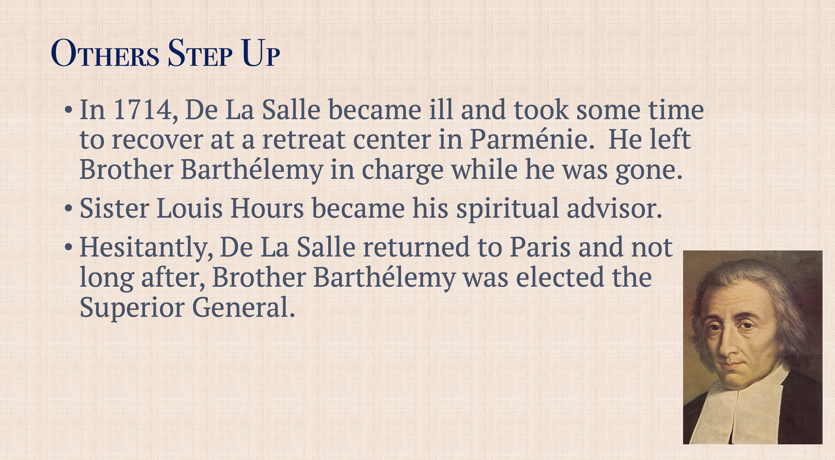
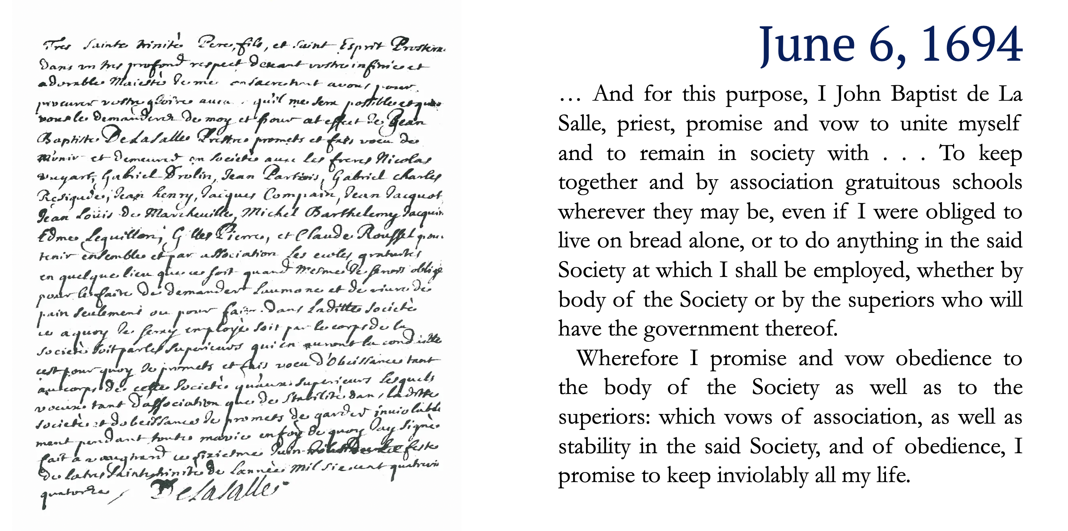
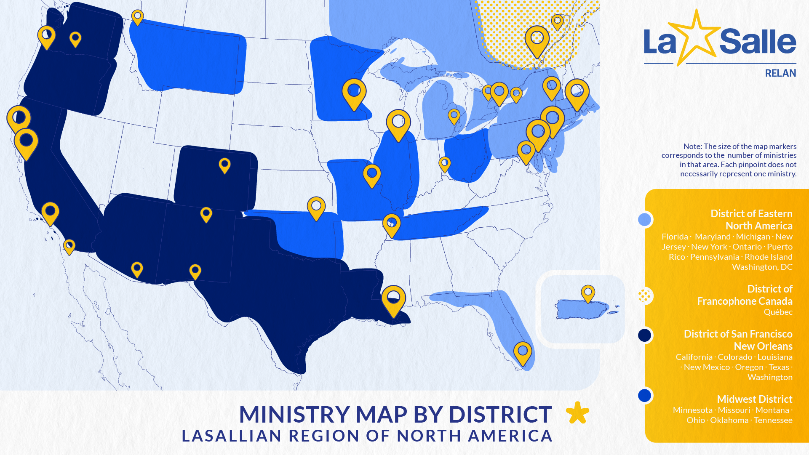
Lasallian Mission Today- Rooted in Tradition
General Chapter meetings
Superior General- leads the Institute of the Brothers of the Christian Schools.
General Councilor is in charge of a region, in the US is part of the RELAN region.
Brother Visitor is in charge of a district.
Notes:
The first General Chapter meeting was the General Assembly meeting in 1694 where the Brothers took the first perpetual vows, De La Salle was elected to continue his role as Superior, and the brothers formally adopted the rule. The rule is a document that outlines of the purpose of the brothers (the 4th vow) and a set of guidelines to help them accomplish that mission. The rule has had different editions and changes throughout time. One early rule that has not changed is they must have a General Chapter or meeting every 7 years with the head brothers to discuss the needs of the Institute considering the needs of the current world.
The first Superior General was Br. Barthelemy (DLS was the founder and elected to be the head of the brothers but he was not the superior general). Br. Barthelemy was the superior general from 1717 until 1720 when he died. The appointment of Superior General has changed over time, it used to be an appointment for life. Now it is for 7 years with the possibility of additional terms.

Slide 4
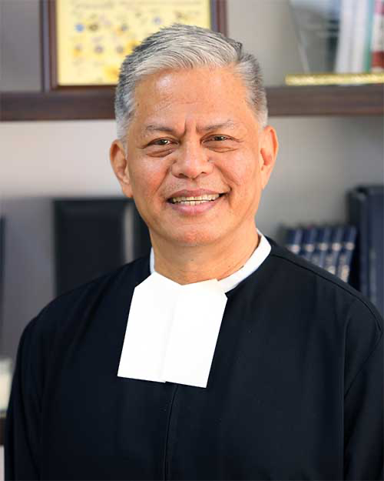
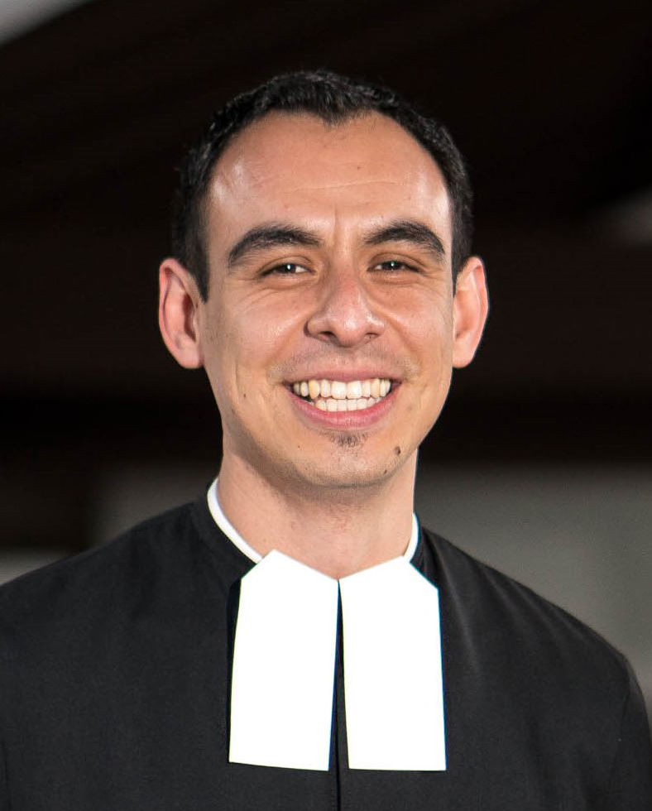
Lasallian Mission Today
Insert picture of your brother visitor.
Br. Chris Patiño, FSC
General Counsilor
RELAN
Br. ___________, FSC
Brother Visitor
District of _________
Br. Armin Luistro, FSC
Superior General
Notes:
Br. Armin is the 28th superior general. He was elected at the General Assembly in 2022. He also received Amnesty International (AI) Philippines’ Ignite Awards in 2020, it is Amnesty International’s highest award for human rights defenders.
Br. Chris is a graduate of the Lasallian school Cathedral High School in Los Angelos
Br. Nick also graduated from Cathedral High School in LA

Slide 5
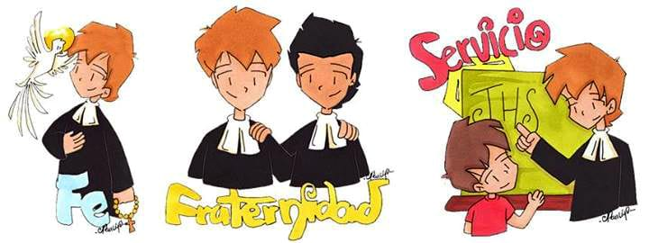
RELAN Numbers
7 Universities (6 in US, 7th is Bethlehem University),
49 High schools, 4 are Cristo Rey
17 Middle schools, 12 are Miguel
3 Elementary Schools,
18 Ed Centers (retreat center, youth/family services),
4 Support ministries (healthcare, retirement, St. Mary’s Press)
600 Brothers, 13,000 Partners, 98,000 students K – college

Slide 6
Our District
Insert pictures of the school crests from other schools in your district.
Notes:
https://lasallian.info/where-we-are/#state t. his web site gives the ministries listed by state

Slide 7
Insert picture of your School Crest.
Notes:
Go over the meaning of your school crest. Invite students to discuss how your school crest is similar and different than other schools.
If you have a school motto, share that with the students and if it is in Latin, translate it to English.
Each school is a combination of our tradition and their own personality based on who we serve; just like each student is a combination of your traditions and your own personalities.
Possible assignment idea: Students get into groups of 4 and create a crest that reflects the identity of each person in the group.

Slide 8
Thank you to the following resources who provided information and images: - lasallianresources.org - lasallian.ai - lasallian.info - dlsfootsteps.org - brothercamillus.com

