Slide 1


God inspires us to walk in the footsteps of his Son.
Meditation 3.3
3. To be “Lasallian”
Notes:
Discussion idea: Ask your students to discuss with a partner what they have heard about the person of Jesus and how they see De La Salle being inspired to act like Jesus. If you feel your students are not familiar enough with the life of Jesus to answer this question, refresh their memory of the slide from chapter 1 and the quote from John 10:10 that says Jesus came so that all may have live and live it more abundantly. Ask them if they believe De La Salle lived life abundantly and why or why not.

Slide 2

The Context
Jesus of Nazareth lived from around 4BCE until 30 CE and led to the creation of Christianity. The Catholic Church is one of many Christian denominations.
The term catholic means universal.
The Brothers of the Christian Schools are an example of one of many Religious Orders that make up the Catholic Church and help the Church carry out her mission.
Notes:
About 40 years after Jesus died, Christians broke of from the Jewish religion over disagreements over whether Jesus was the messiah or not and created a new religion.
At first when there was only one type of Christianity, catholic was used as an adjective as a way to describe this weird new religion that was not tied to one culture but was made up of people from many different cultures. This religion is universal meaning it is for everyone.
This makes the Catholic Church very diverse. This also means it requires a bunch of different gifts to serve all the needs of the diverse people who make up the Church. Charism is the Latinized form of the Greek word kharisma which means favor or divine gift, Different groups share their unique gifts to build up the Church.

Slide 3

Other Religious Orders
Dominicans were founded by Saint Dominic to proclaim God’s word in our world.
Vincentians and Daughters of Charity are founded by Saint Vincent de Paul and Saint Louise De Marillac. The community was established for the purpose of serving the poorest of the poor.
Marist Brothers were founded in 1817 by Saint Marcellin Champagnat to make Jesus. Christ known and loved through education.
The Order of Saint Augustine was founded based on the life of Saint Augustine and the monastic lifestyle, they attempt to reflect the mystery of the Trinity.
Notes:
Here are some other examples of charisms.
Pope Leo is part of the order of St. Augustine.

Slide 4
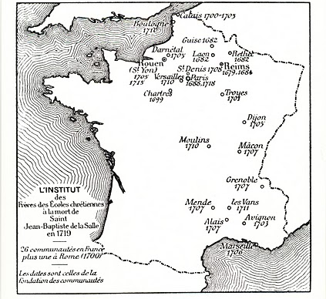
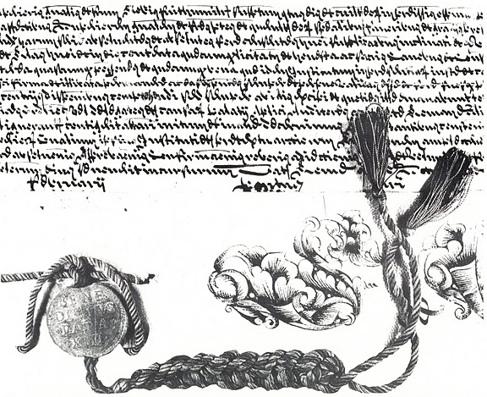
The Institute
At the time of De La Salle’s death, there were 101 Brothers and a number of schools in France.
In 1725, the Papal Bull of Approbation was issued by Pope Benedict XIII, which officially recognized the Institute of the Brothers of the Christian Schools as a religious order.
Notes:
They had at least one school in 13 towns plus 1 in Rome.
The Papal Bull of Approbation was issued on January 26, 1725 and officially recognized the Institute of the Brothers of the Christian Schools as a religious institute dedicated to teaching the poor, with the profession of teaching incorporated into their consecrated life. De La Salles wanted the Institute receive legal standing in the Church and recognized as an official religious order but he never tried to receive the status while he was alive.
The Institute of the Brothers of the Christian Schools is the official name of the international organization of the Brothers. An individual Brothers belongs to the Institute and takes vows to the Institute.

Slide 5

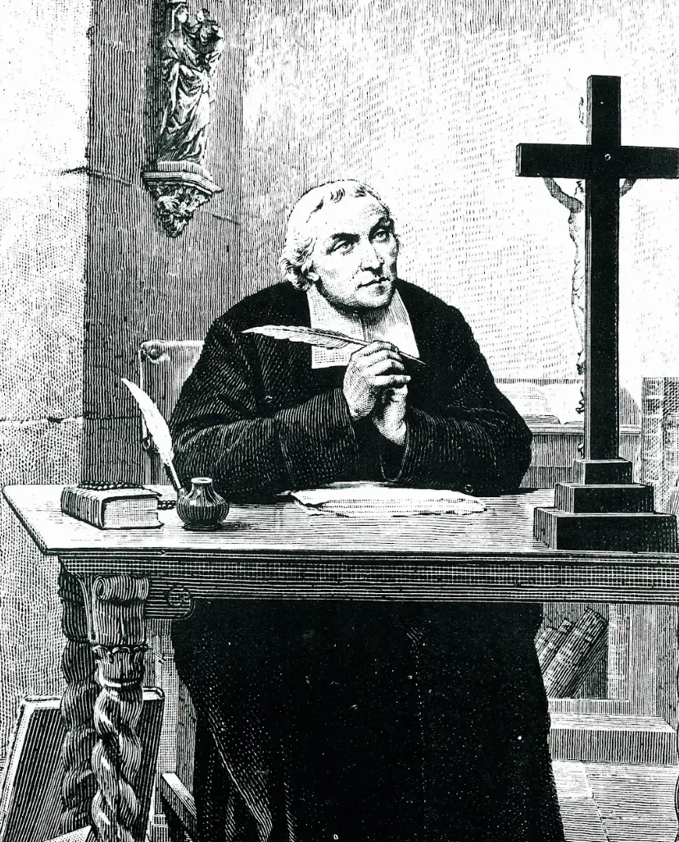
Why is De La Salle the Patron Saint of Teachers?
Clear purpose
Commitment
Notes:
Ask the students to discuss: What qualities make a teacher a good teacher? Focus on the characteristics, not names.
What do you think is necessary for these teachers to develop these characteristics? For example, if they say a good quality is patience, what do they think would help a person become patient? Experience or time? What else?
What do you think De La Salle would say?
He did not really say but when you look at what he did and how he trained the teachers, there are two main themes that are evident. De La Salle did not train his teachers to see their work as merely a job.
For example, think about the difference in the quality of work for the classes you think of as a “have to” class and the classes that you love. When something is only a job or you are only doing it for a grade or a paycheck it may get your effort but it will not get your heart.

Slide 6
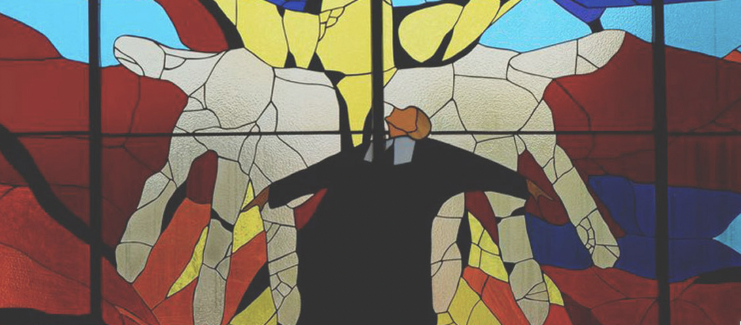
Clear Purpose- Innovation in Teaching
Teaching is a vocation, not merely a job.
Vocation is a calling or an invitation from God to a personal relationship with God.
Education brings about salvation.
Education is a way to help students discover their own vocational path.
Notes:
Do they remember the definition of vocation? (page 17 from the book)
De La Salle was a priest and would have been familiar with the idea of vocation and that all of life is an invitation from God. He was introduced to this at a young age when his grandmother read to him the lives of the Saints and it would have been taught in the seminary. De La Salle took this idea and applied it to the life of teachers and elevated the role of teacher to an expression of religion.
De La Salle taught the Brothers to say a prayer upon entering their classroom. This is a clear reminder that God is present in the classroom and not just in a Church.
Salvation comes from the Latin word “salvare” meaning “to save,” and the Roman goddess Salvs, the goddess of health and wholeness. Health is very much a physical problem, the first level of salvation has to do with your well being in the earthly world. Your wholeness is more than physical. When you think of wholeness, this includes happiness and peace this has to do with your spiritual well being and in the Christian context, your relationship with God and your ability to rejoin God in heaven.
De La Salle believed education was the best way to bring about both physical and spiritual wellness.
De La Salle was clear that the purpose of education both originated with God (vocation) and strove toward God (the student’s vocation and salvation). This vocation is worthy of the commitment and dedication of a lifetime.

Slide 7
Commitment
Poverty
Chastity
Obedience
Association for the service of the poor through education
Stability in the institute
To own nothing individually
To abstain from sexual activity
To listen to God and the Brothers
To provide salvation through education to all, in particular the poor
To be a positive contributor to the mission
Notes:
The first three are evangelical counsels vows promised by all religious orders in the Catholic Church.
Poverty: an intentional act of humility and trust in God’s providence.
All people are called to be dedicated to their vocations. If married, they are asked to be faithful to their spouse, if living as a member of a religious community to remain dedicated to the mission of their community.
Brothers vow of obedience is to their superiors and to the body of the brothers. When De La Salle was at Parmenie he was reminded of this vow that he is to be obedient to the brothers, even though the was in charge.
This vow is central to the identity of the brothers and makes them different than other religious orders. There are two aspects to this vow, the first is the mission of the brothers and the second is the communal bond of the brothers.
With stability, one promises to devote themselves for life

Slide 8
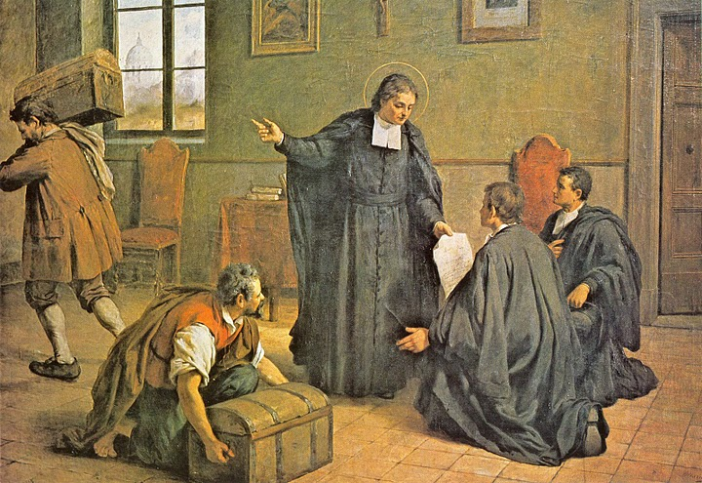
Community and Charism
It is a great gift of God, this grace he has given you to be entrusted with the instruction of children, to announce the gospel to them and to bring them up in the spirit of religion…this is the work of God.
- Meditation for the Time of Retreat 201.1
Notes:
This vocation is from God. God also provides what you need to live your vocation. As DLS said, God gives grace.
Idea for discussion question: what do you believe would help the Brothers to live this clear purpose and commitment?

Slide 9

Community and Charism
Community: A group of people joined TOGETHER and by ASSOCIATION for the same mission.
Charism: Gift received and gift given to help the Church continue her mission.
Faith and Zeal
Notes:
This vocation is from God. God also provides what you need to live your vocation. As DLS said, God gives grace.
The first gift is the community. The vows emphasize this idea of community. DLS emphasized community first by inviting the teachers into his home and then moving out with them to the cradle of the institute, by creating the habit and writing letters to each brother and taking the vows. This commitment of vows takes place in an educational community where teachers are associated together to live out their vocation to teach. Think about the very nature of them choosing to call themselves ”brothers”.
Charism is not only the gift an order gives to the world but God also gives the order gifts so they may be able to provide this gift. Remember DLS’s meditation, this is the work of God, not just individuals who want to do good. If it was just up to the individuals, most would give up as it is too much work and too difficult a life.
There are many gifts God can give to people and each person or group receives different gifts (1 Corinthians 12:4-7) best suited to their vocation. The gifts DLS believed the brothers received are faith- the ability to see the will of God and zeal- enthusiasm. These two gifts, in combination with their community make this commitment possible, their purpose clear, and have sustained the Brothers for the last 300 years.

Slide 10
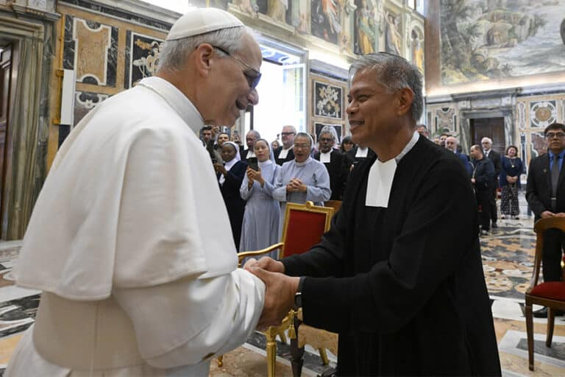
ADDRESS OF THE HOLY FATHER LEO XIV TO THE BROTHERS OF THE CHRISTIAN SCHOOLS Thursday, 15 May 2025
"After three centuries, it is wonderful to see how your presence continues to carry the freshness of a rich and far-reaching educational reality, through which, still today and in various parts of the world, you devote yourselves to the formation of young people with enthusiasm, fidelity, and a spirit of sacrifice.”
Notes:
https://www.vatican.va/content/leo-xiv/en/speeches/2025/may/documents/20250515-fratelli-scuole-cristiane.html
The pope even brought up these two gifts of faith (fidelity) and zeal (enthusiasm) as part of Brother’s identifying characteristics.
He also went on to highlight their 4th vow as a reminder to all how the Brothers quickly fulfill the baptismal call we all invited into.

Slide 11
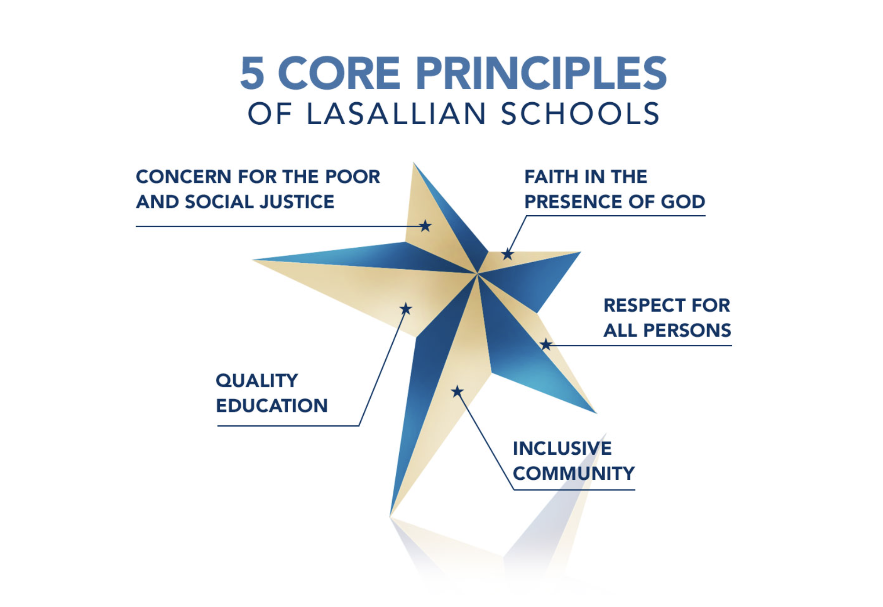
Notes:
Faith in the presence of God: This LCP does not necessarily mean you believe in God. It means we as a school believe in God.
Notice, the wording is not faith in God. Why do you think this is? It is faith that God is with you. This is a whole different level of faith. A Catholic nun, Mother Angelica said “Simply believing in the existence of God is not exactly what I would call a commitment. After all, even the devil believes that God exists! Believing has to change the way we live.” It is a belief that God is present and an active influence in our daily lives, within our friendships, our extra curriculars, and our classes.
Respect: Discussion question idea: What are examples of respect? So then, what does respect mean? The etymology of respect means to see again. Spect- like spectacle or spectators. So respect means to see someone for who they are, it means to see someone with new eyes over and over again.
Inclusive Community: Discussion question idea: What does it mean to be an inclusive community as opposed to a community? Inclusive means everyone is included and belongs. This is different than everyone being accepted it means everyone feels they are valued and that this school belongs to them. Does this change our answers to before? Do our actions demonstrate respect for all persons we encounter and do we include all members of our school community?
Quality education: Discussion question idea: What does this mean? What is the difference between an education and a quality education? The DLS favored the term Free Christian Schools to distinguish the Brothers' schools from the other charity schools that existed at that time because charity schools were known to be chaotic run by underpaid and undertrained writing masters. De La Salle insisted on trained teachers, cleanliness, politeness, discipline and -- what was most unusual for the time-- regular attendance.
Concern for the poor and social justice: Discussion question idea: Why both? Why not just concern for the poor? What is the difference between the two? One loves an individual person and helps them their current situation. Social Justice works an institutional level to prevent this from happening to people . A “social” justice is concerned with the care that “free and responsible people” have for one another, and builds a common good instead of just an individual good. It is also achieved through social means, through developing skills that enable groups to do much more than any one individual can do: forming associations, being willing to take leadership of small groups, and developing a habit of cooperating with others.

