Slide 1

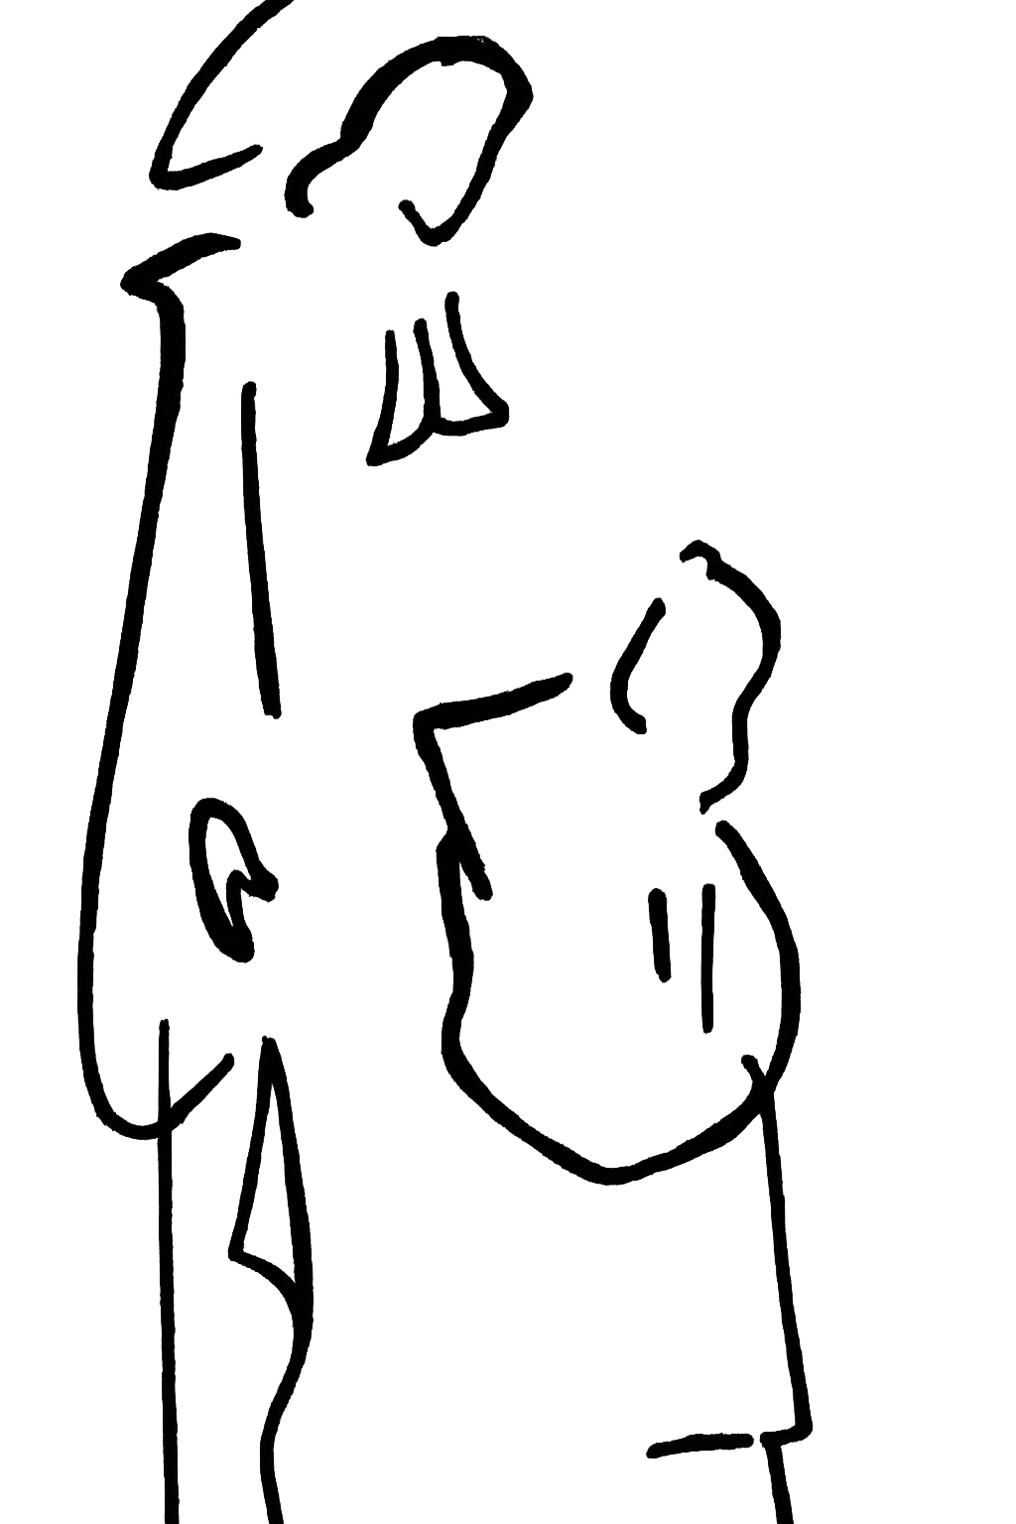
2. Life of De La Salle
Wherever I go I will find you, my God.
-Explanation of the Method of Interior Prayer:

Slide 2
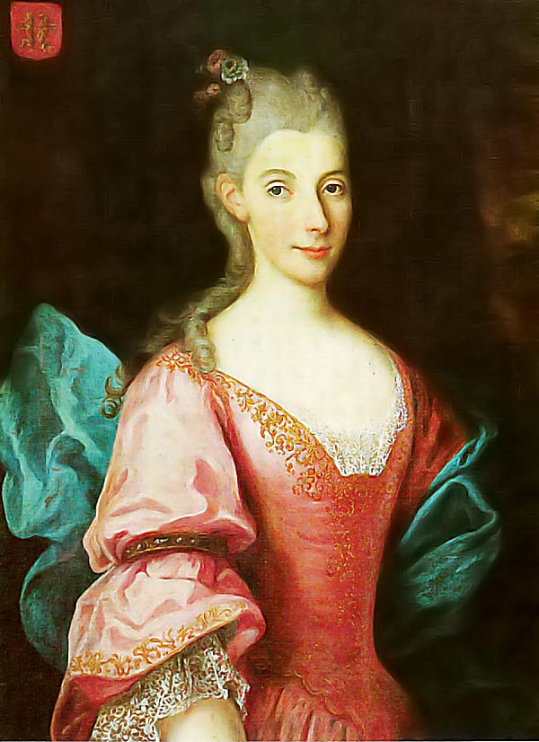
Family
Occupation: Judge
Social Class: Upper Bourgeoise
Occupation: Housewife
Social Class: Nobility
&
Louis de La Salle
Nicole Moët de Brouillet
John Baptist,
1651
Remy,
1652
Marie,
1654
Rose-Marie,
1656
Marie-Anne,
1657
Jacques-Joseph,
1659
Jean-Louis,
1663
Jean-Louis,
1664
Pierre,
1666
Simon,
1667
Jean-Remy
1670
Notes:
Dad’s family were wool merchants but he chose to become a judge. They were upper bourgeoisie so his family had money but were not extremely wealthy.
Mom came from the family that produces Moët & Chandon Champagne. She came from big money and from the noble class and this is why we have a painting of her.
Louis and Nicole’s families were friends which is how they met. She had to give up her nobility title when she married Louis.
To review, here are the social classes in France at the time: Classes in France were based on inherited, within social classes there were levels based on the economic status of the family.
Clergy (wealthy upper class who would have been in the more urban churches and poor lower class who would have been in smaller churches)
Nobility (they had property and the king knighted them. This title was inherited or purchased)
Bourgeoisie (middle class, they work and run things, like city council or lawyers, major business owner)
Peasant (the poor)
The children written in black font died in childhood. It was common to have a large family and for children to die.

Slide 3
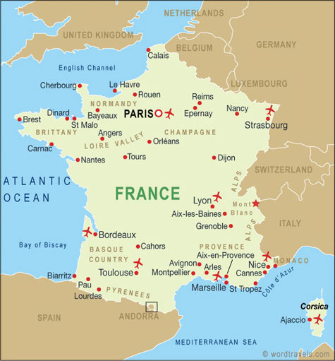
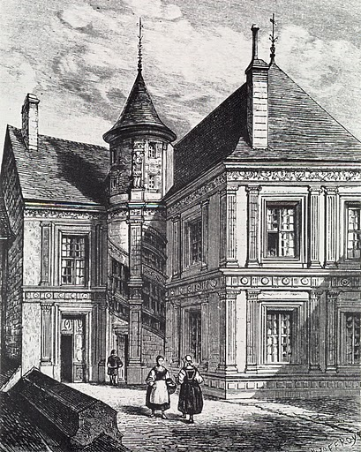
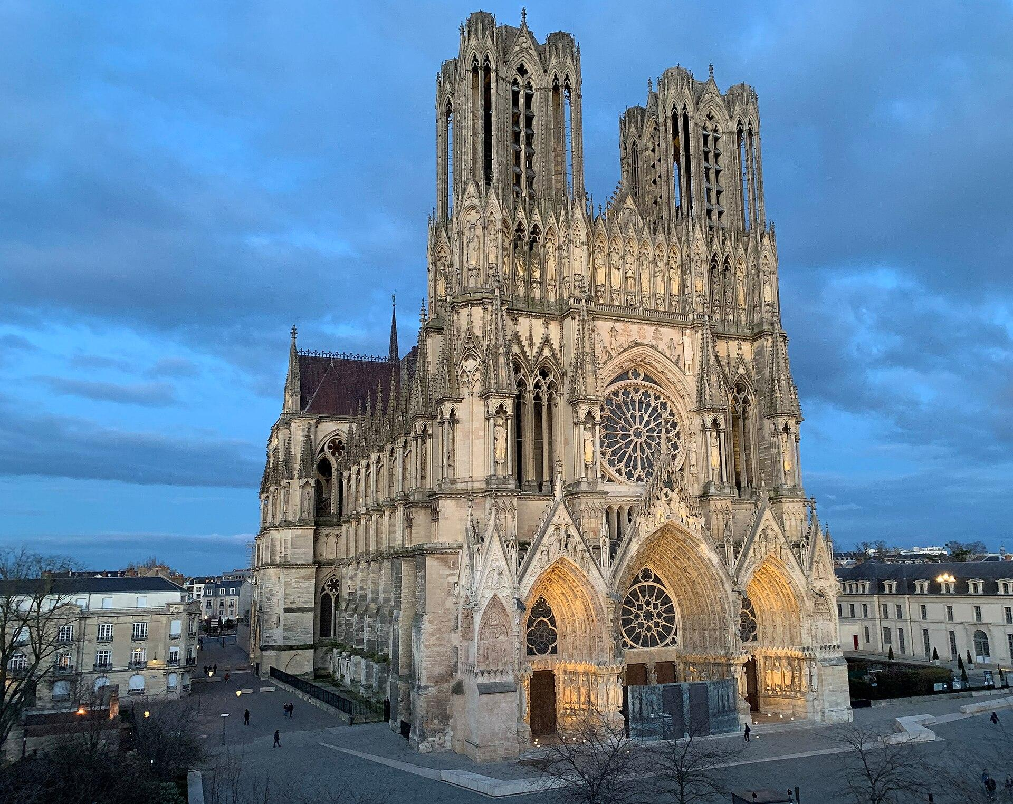
Childhood
Born in Reims, France on April 30, 1651.
His family title was upper bourgeoise but, because of his mother, he was raised with the manners and money of the nobility.
Cathedral of Reims
Hotel de La Cloche
Notes:
Reims was a sizable and influential town known for it’s role in the wool industry and the Cathedral of Reims hosted the coronation of kings since Clovis I in 496. Louis XIV was anointed June 7, 1654 when DLS was 3 years old.
His family was well respected and connected within Reims. Hotel de La Cloche was the family home until he was about 13 years old. The house is one of three notable downtown homes that survived WWI however it was stripped. is now owned by the brothers.

Slide 4

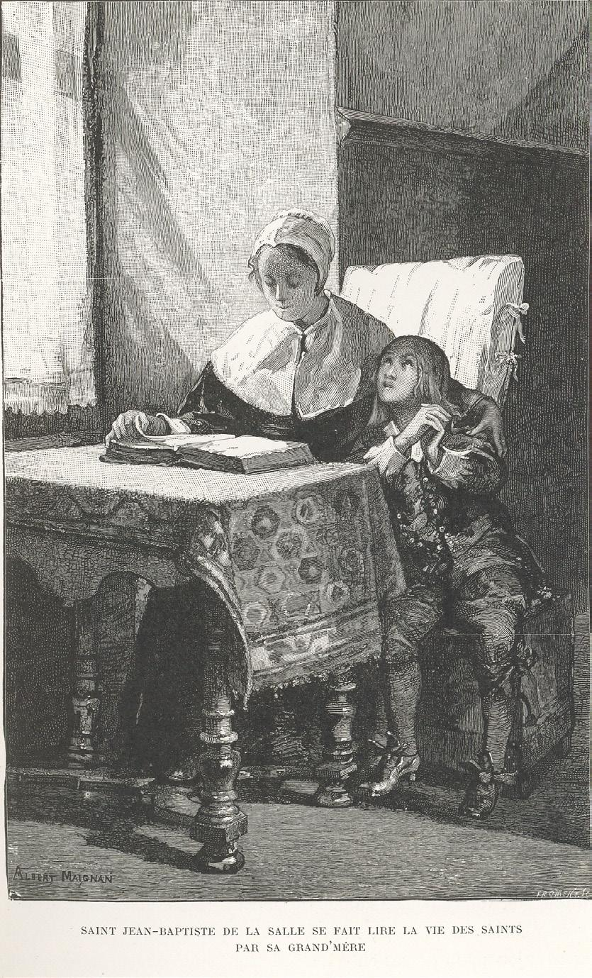
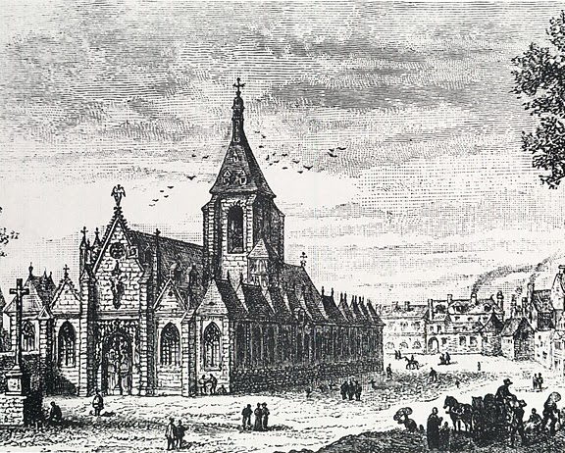
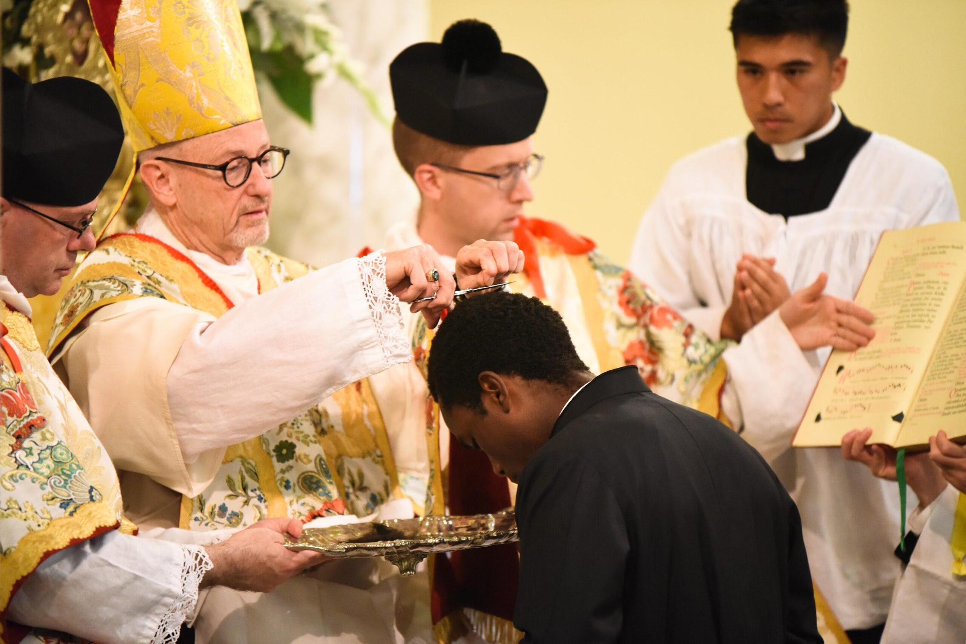
Religious Formation
Father Pierre Dozet invited De La Salle to receive the tonsure at 10 years old.
At 15, he became a canon for the Cathedral of Reims.
In 1670, at age 19, De La Salle enters the seminary of Saint Sulpice.
Born into a devout Catholic family, De La Salle attended Church and received his sacraments.
His grandparents were his godparents and took their role seriously teaching him prayers and the lives of Saints.
Notes:
The family was known for their piety. Three of the boys became priests- De La Salle, Jacques-Joseph, and Jean-Louis. Rose-Marie became a cloistered nun. At the age of 7 he became an altar server at the Cathedral.
Perrette was his maternal grandmother and only 36 years old when De La Salle was born (she was only 14 when she got married and Nicole waited until she was 16). Perrette Lespagnol read to him the lives of saints (image). She was also involved in social justice causes and may have influenced him in this way as well. His grandfather, Jean Moet taught him to pray the divine office.
Father Pierre Dozet was his grandfather’s cousin. The tonsure signifies a person's separation from secular life and dedication to God and the service of the Church; it shows his dedication to his calling of priesthood. It was not unheard of for someone to receive a tonsure at the age off 10 during the seventeenth century but it was young. His parents approved of the ceremony and it does slightly break tradition because often the oldest son would take over the family business. From then on, he would have gone to school (at that time the College des Bon Enfants) in a black cassock.
The same Father Pierre Dozet, resigned as canon in the Cathedral of Reims and left the position open for De La Salle to fill. The position was a prestigious one, especially for someone so young, because it was a paid position and he was given administrative duties, asked to participate in prayers(Liturgy of the Hours), and processions on holy days.
Many high-ranking members of the Church had been canons of Reims, including former popes (Pope Sylvester II, Pope Adrian IV, Pope Adrian V) and St. Bruno. Bruno was a canon of Reims in the 11th century and became a saint after founding the Carthusian order, which would play a part in forming De La Salle’s spirituality.
Seminary (Latin for greenhouse) meaning it is a place where the mustard seed of faith is nurtured, fed, formed and grows.
The Society of St. Sulpice was founded by Jean-Jacques Olier with the express intention of training and supporting priests. Sulpician spirituality was Christocentric, that is, very focused on the person of Jesus Christ. This focus on Christ highlighted building relationships with God by serving those in need, especially the poor.

Slide 5
Academic Formation
Degrees
Private tutoring
Collège des Bons-Enfants
University of Reims
Seminary of Saint Sulpice and Sorbonne University
University of Reims
1669, Masters of Arts Degree, Summa Cum Laude
1678, Licentiate in Theology
1680, Doctorate of Theology
Notes:
1657-1661; as was customary of the wealthy, DLS was educated by private tutor in his home.
1661-1669; College des Bons-Enfants
He studied Latin and Greek Grammar. Then followed 2 years of rhetoric (oratory, debates, plays, poems, discussion—all in Latin) and 2 years of Philosophy (including Aristotle, logic, ethics, botany, math, astronomy, and metaphysics). The lessons were given exclusively in Latin.
In April 1663, DLS had a secondary role in a school play dealing with the martyrdom of Saint Timothy.
In 1665, he was awarded the second price in elocution and honorable mention in extempore declamation showing he was proficient at rhetoric and public speaking.
DLS graduated with a Masters of Arts degree Master of Arts degree and awarded his degree summa cum laude from the University of Reims.
He also completed his first hear of his theology degree at the university of Reims but a lawsuit happened between the professors and the chancellor of the school and a question as to whether the exam scores would be valid which is most likely why DLS transferred the next year to a seminary in Paris.
1670-1672; While attending the Seminary of Saint Sulpice he also took classes at the Sorbonne University.
While at Sorbonne he was ranked 10th out of 93 students and one of his professors would later help him edit and publish books he wrote.
1672-1680; After needing to move home, he finished his studies.

Slide 6

Roadblocks
In 1671, as De La Salle was attending the seminary, his mom died and about six months later his father died.
He must leave the seminary in Paris to return to Reims to care for his younger brothers and sister. He becomes their legal guardian.
Notes:
His father died in 1672.
As the oldest son he was expected to deal with the estate but more importantly, he was expected to take over caring for his siblings. His youngest sibling, Jean-Remy was almost 2 years old when their father died.

Slide 7
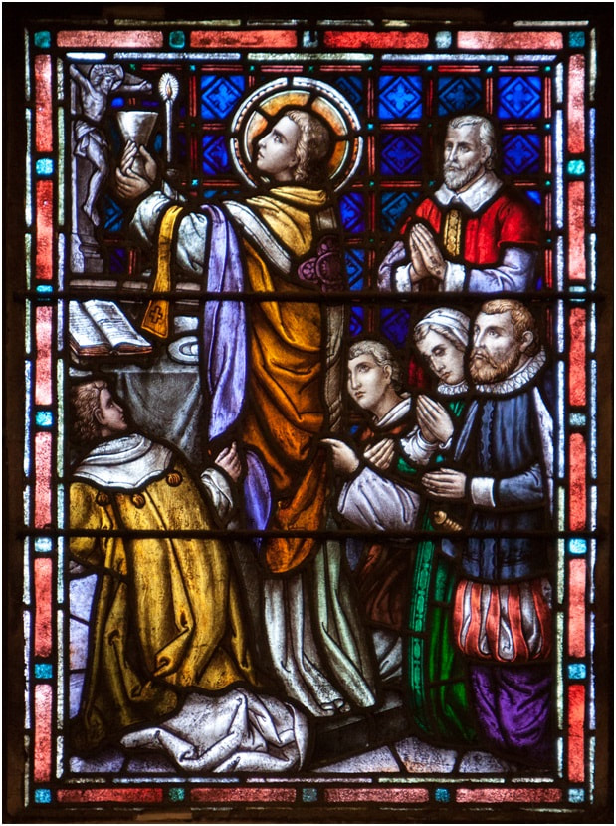
Roadblocks
When De La Salle returned to Reims, he reenrolled at the University of Reims and Father Nicolas Roland became his spiritual advisor.
In 1678, De La Salle was ordained a priest and said his first Mass on Easter Sunday.
Stained glass window at the Chapel of St. Mary’s College, Moraga
Notes:
Discussion topic: In 2025, at YLA, a student asked a panel of adults how to know if something difficult or sacrifice is of the world or of God. This is a very insightful question. When something goes wrong, how do you know if this is something God wants you to over come or something to avoid? Is the road closed or is it a detour?
Nicolas Roland was also a canon at the Cathedral of Reims and was known for his eloquence and knowledge. As a spiritual director, Roland's task was to help De La Salle grow his own relationship with God and recognize how God is present in his life. Roland encouraged De La Salle to continue on his vocational path toward priesthood.
A possible activity is to ask the students to meditate on window 2 with Br. Camillus Chavez, fsc. https://www.brothercamillus.com/de-la-salle-windows-meditations.html

Slide 8
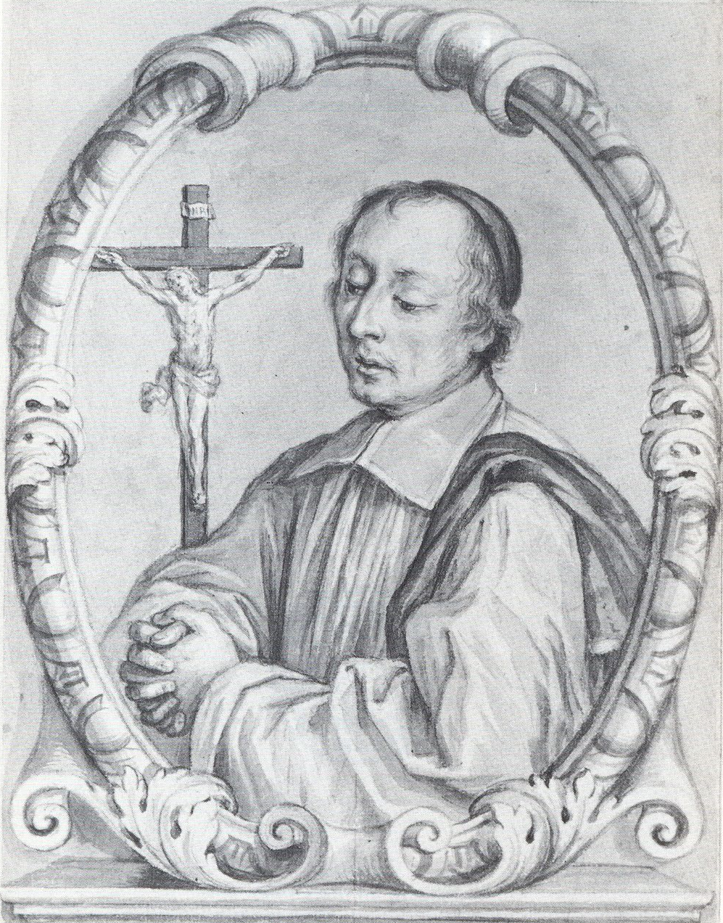
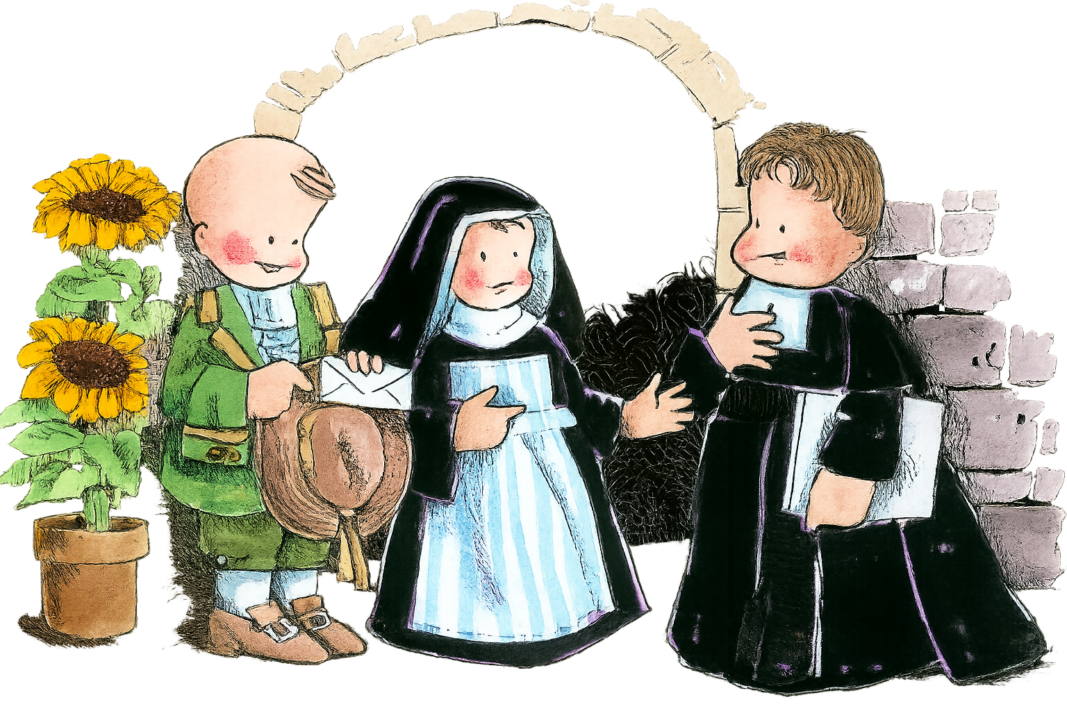
Chance Encounter
It is also through Father Roland that De La Salle became involved in caring for a group of nuns, the Sisters of the Holy Child Jesus, who taught poor girls.
Through these nuns De La Salle met Adrien Nyel, a man who wanted to open a school for poor boys in Reims.
Father Nicolas Roland
Notes:
Father Nicholas Roland founded the Sisters of the Holy Child Jesus and was working on getting them legally recognized when he died. Nicolas Roland died on April 26, 1678, at the age of 37 and at the time of his death, there were about 20 nuns running 4 schools and 1 orphanage. He asked De La Salle to be the executor of his role and to finish the process of getting the letters patent from the king to assure it’s legal status. With De La Salle’s help, they received the official decree November 12, 1683.
. Roland's work laid the groundwork for the Institute of the Brothers of the Christian Schools. He was beatified by on October 16, 1994.
The main charism of this group of nuns was to educate poor girls and orphans in the town of Reims.
Adrien Nyel was born around 1621 near Laon, a town north of Reims. He was passionate about creating schools for poor boys, he saw there were a lot of groups of nuns who had taken on the teaching of girls and there were groups of men, like the Jesuits, who educated wealthy boys but there was not many, if any, options for poor boys. He had opened four schools in Rouen, a town west of Reims. He received a lot of support and money from Madame Jeanne Dubois Maillefer, a wealthy lady of Rouen and relative of De La Salle, and she had recommend he also start schools in Reims.
Nyel went to Reims to create more schools and started by going to the Sisters of the Holy Child Jesus as they would know who would be supportive of his mission and who he could ask to be a donor. It was on the steps of their house Nyel met De La Salle.

Slide 9

First Steps
De La Salle’s initial involvement included:
inviting Adrien Nyel to stay in his house while in Reims,
talked with his priest friends to find a parish to host opening a school,
giving money to support the teachers.
Notes:
De La Salle was not the only donor but he did agree to pay 200 livres to help pay for the lodging of 5 teachers hired to teach at the first schools.
It was not De La Salle’s idea to start the schools and initially, he thought his role would be external. Certainly nothing more than providing financial support and perhaps being a spiritual advisor of sorts.

Slide 10
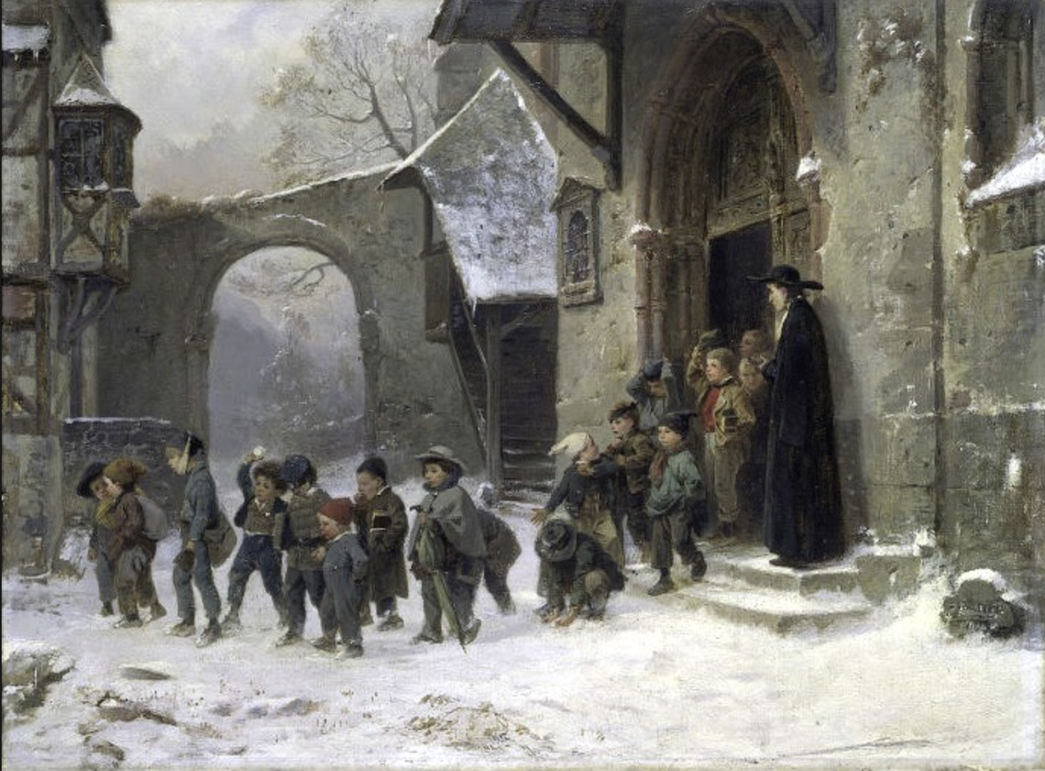
In 1679, they opened the first Free Christian School in St. Maurice Parish and another shortly after at St. Jacques parish.
Notes:
In 1680, he opened a third school in Symphorien Parish.
Free Christian Schools are the names of the schools De La Salle started.
Painting – Children Leaving School – Benjamin Vautier (1829-1898)
This popular painting by Benjamin Vautier (1850’s) shows a group of boys leaving school amidst a snowy scene, with a Brother at the door watching them with benign amusement. The painting is hung at the Victoria and Albert Museum (London).

Slide 11
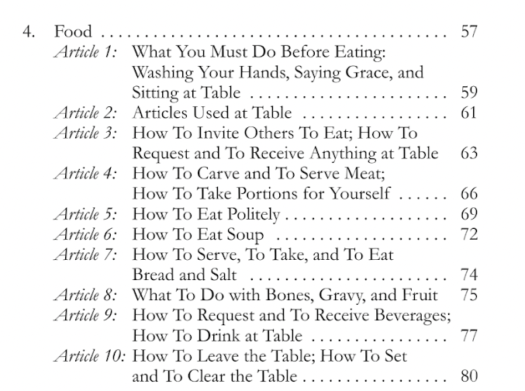
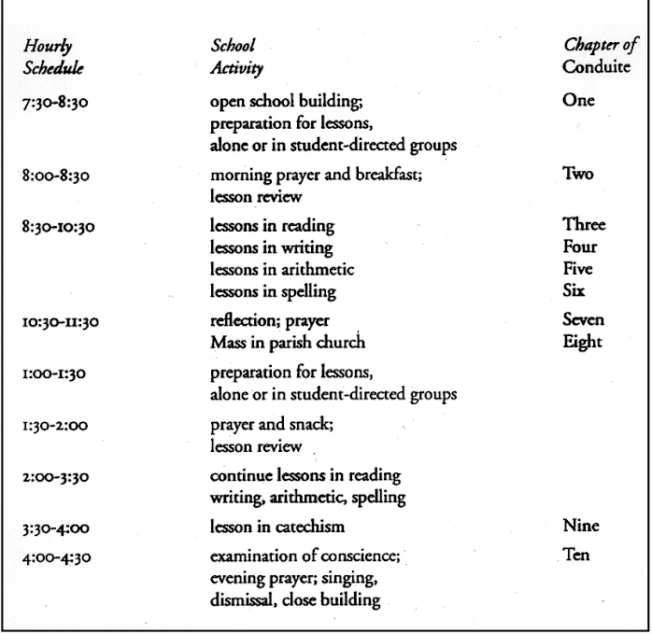
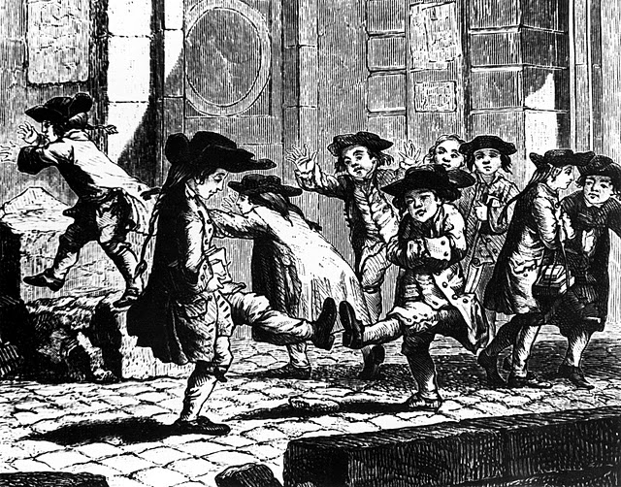
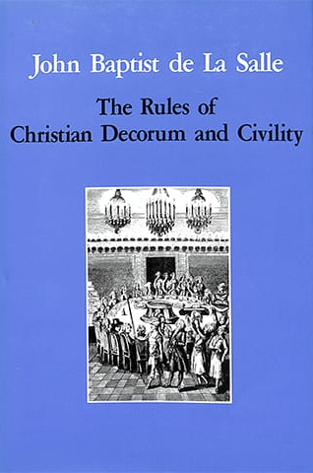
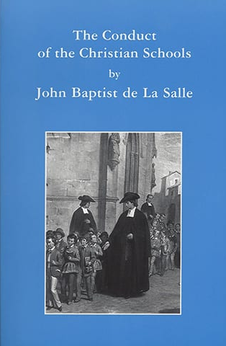
Becoming Involved
Adrien Nyel was focused on opening new schools; who was focused on running the schools?
De La Salle saw the new schools were struggling and invited the teachers to his house for Easter dinner in 1680.
A year later, on June 24th 1681, De La Salle invited the teachers to move into his own house.
Notes:
After opening the schools in Reims, Nyel opened a school in the towns of Rethel in 1681, Guise and Chateau Porcien in 1682, and Laon in 1683. He was focused on fundraising and networking to open new schools which often took his attention away from the needs of the schools he already started. Many of the schools faced problems because he did not establish strong leadership to run the schools in his absence. In addition, the teachers he hired were not adequately trained to be teachers. Nyel did not hire writing masters as they were too expensive. So he hired
Students were all over the place because there was not a lot of discipline or set of policies established in the schools. The teachers were also barely literate themselves.
De La Salle realized at this first dinner the inadequacies of these untrained teachers and at that first dinner started teaching them. He realized these teachers would not be successful without his support. This is not because he was trained to be a school master but because he had received an excellent education, a better education than these teachers, so he shared with them what he had learned.
His training covered literacy basics, classroom management, lessons in religion and faith, hygiene, and manners.
He was not impressed with his teachers, he found them repulsive and lower status than his butler. De La Salle said, “In fact, I experienced a great deal of unpleasantness when I first had them come to my house.” This probably inspired him to later write a book on manners and include a whole section on eating with other sections on how to cough and how to blow a nose.
Obviously he cannot cover all of this in one dinner so he asked the teachers over to dinner every night. He quickly realized that was not enough so he asked the teachers to come to his house at 7 in the morning before school for training and to return to his house after school. The teachers would return to his house after school and would work up until dinner and then go home after dinner.
When Nyel came back into town, he was impressed with how much the teachers improved and encouraged De La Salle to continue his work in forming the teachers. De La Salle really had to teach everything, including the content of lessons, how to teach lessons, how to assess student learning, to how to manage students who misbehave, how to establish a schedule for the school day, and how to open up the classroom. In 1706, De La Salle wrote these lessons in the book The Conduct of the Christian Schools.
Nyel died in Rouen May 31st 1687.

Slide 12
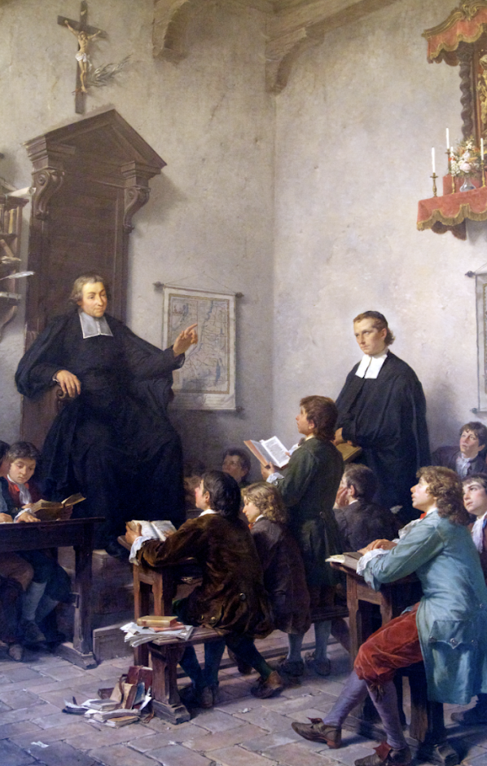
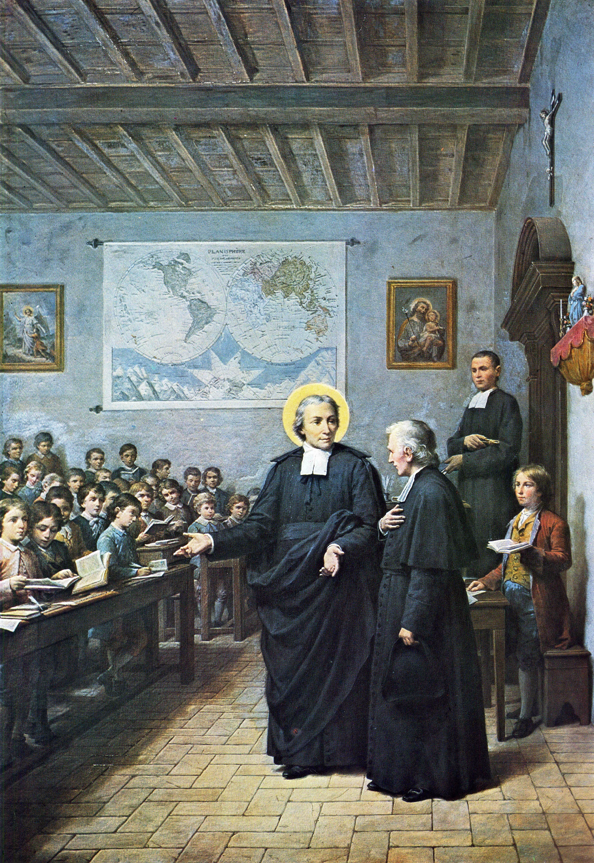
The teachers and schools became more successful under De La Salle’s guidance.
De La Salle’s family was not happy with the impact of De La Salle’s decisions on the family.
Notes:
Often you may see paintings of De La Salle in the classroom but De La Salle did not actually teach students and rarely if ever stepped foot in an actual classroom. This second painting symbolically shows De La Salle’s role better, he did not teach students he is known for teaching the teachers how to teach.
John Baptist de La Salle’s society viewed the lower-class people employed as teachers as being a bad influence on De La Salle’s three remaining younger brothers who were still living at home. As a result, eventually only Jean-Louis, De La Salle’s 17 year old brother, remained in the house. All other siblings moved out.
In the end his sister Marie sued him to divide up the inheritance, both the money and the properties. There was frustration that he was spending money on these schools and concerns that he was spending money belonging to the siblings on the schools. In addition, he was allowing the teachers to live in the family home. It was found that he kept meticulous records and he spent his own money, not family money but that the properties must be sold and the proceeds divided amongst the siblings. This forced De La Salle and the teachers to find a new place to live.

Slide 13
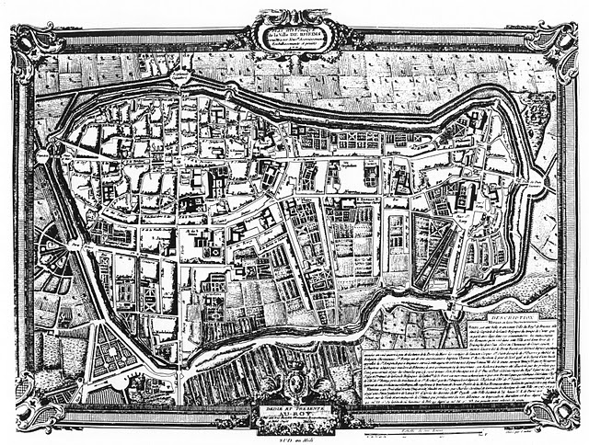
DLS family home
St. Maurice Parish, 1st school
City hall
Sisters of the Holy Child Jesus
St. Jacques, 2nd school
Notre Dame Cathedral
1st Brothers house
Notes:
(FYI actual name of the Cathedral is Notre-Dame de Reims)
Inside inner wall (upper left oval) is where the wealthy live, the closer to city center the more important… look at where his family home was. Where were the schools he created? So who did he serve? Where was the house he rented?
De La Salle’s move to the poor part of town was a dramatic culture shift. One small example of this was he was not used to the food available to the poor, and it caused him to be sick for two years. This move also cut him off from his family. They would not visit him, with the exception of one visit from his grandmother when he was especially sick.

Slide 14
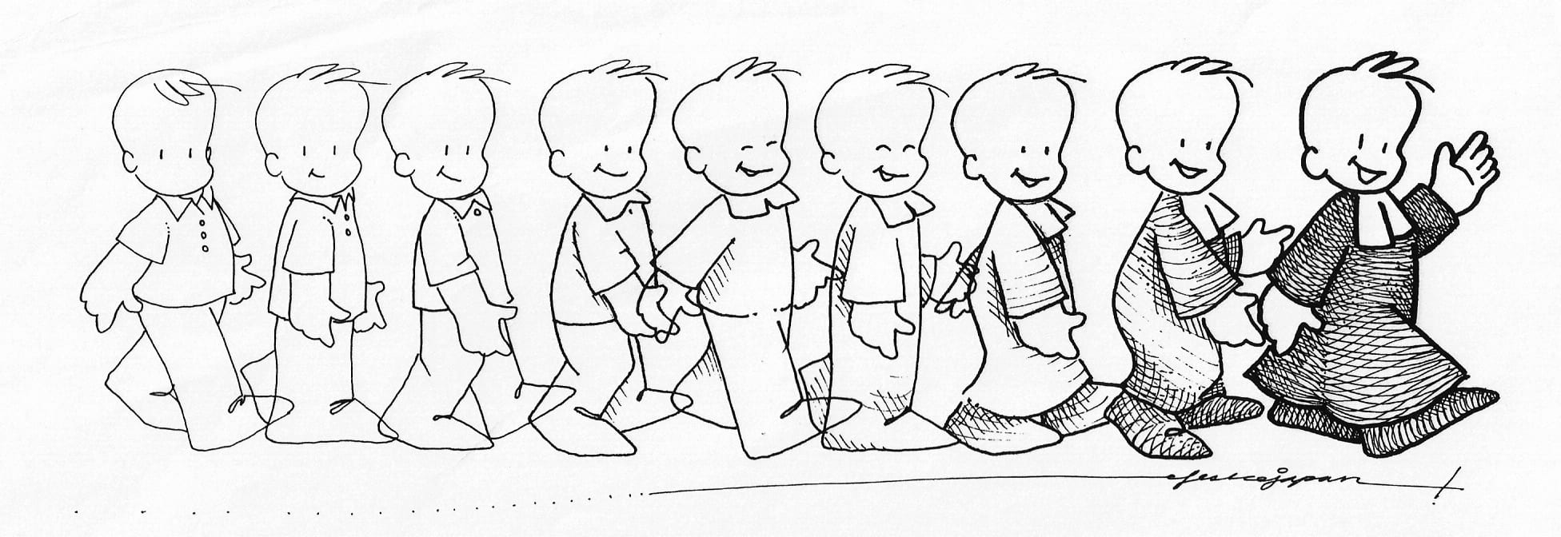
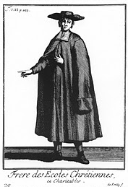
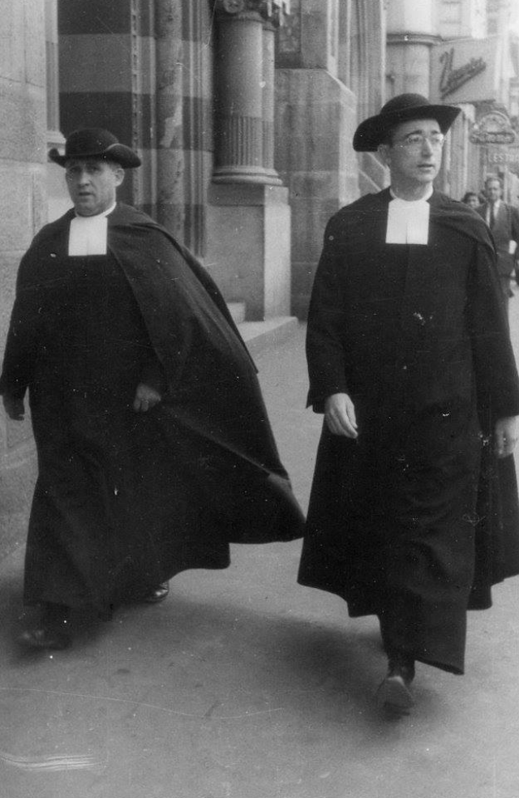
Becoming Brothers
De La Salle and the teachers moved into their first house, the “Cradle of the Institute.”
In 1686, DLS got the 12 head brothers together for a meeting called an Assembly.
They adopted the name Brothers of the Christian Schools.
Adopted a habit
Took a vow of obedience for 3 years.
Notes:
De La Salle’s invitation to the teachers to live together brought with it a lot of responsibility. The teachers were expected to take their training seriously as well as live a respectable life and engage in religious exercise together. De La Salle created a schedule for the teachers based on his life in the seminary. For many of the teachers this was not a sustainable situation and most of them left by the end of the year. Two or three stayed with John Baptist de La Salle. New teachers came to replace those who left, and eventually there were more teachers than before in the community.
De La Salle lived there from 1682-1688.
Head brothers means the 12 teachers that he thought was most committed to what they were doing and had been doing it for a long time.
General Assembly: meeting, still have these to this day every 7 years, last meeting was in May 2022.
Brother of the Christian School is their official title. Br. Joe Smith, FSC. (FSC latin for Fratres Scholarum Christianarum= Brothers of the Christian Schools).
Habit- black robe shows they are religious, but they are different then priests, smaller belt and no buttons they used hooks b/c they were cheaper, more simple. Their tie (rabat) showed they were teachers. People often made fun of their outfits because they were new and cheap. One brother wrote a letter of complaint to DLS that people were throwing things at them as they were walking b/c of their clothes. (Pass the doll around the class). The choice of the clothing for the habit was intentional: it was a long black robe to show that they were a religious community but it was made out of cheap fabric and hooks rather than silk buttons to show their vow of poverty. They also wore a particular collar to indicate they were teachers as opposed to priests. Each brother was also given a hat and a cloak to help them during cold weather and the cloak would often be used as a blanket at night. A fun activity could be to ask the students to critique your school’s dress code or create a dress code that displays your school’s values just as the habit displays the vows of the brothers.
The left image is from a book on French fashion in the 17th century, this page is comparing the religious habit of a couple religious orders, the brothers are the top, right image. The right image is a picture from the 1950’s of Br. Firmus Aloysius (right) and an unknown American brother
DLS was afraid to ask for a lifetime commitment because he thought no one would say yes so he asked for three years and it was renewable.
Possible assignment idea: Ask the students to create a new school dress code that, like the habit, attempts to communicate the mission of your school.

Slide 15
Difficulty
De La Salle was struggling balancing the demands of all the different positions he held. In addition, De La Salle’s multitasking strained the relationship with the teachers as they questioned his level of commitment.
De La Salle | The Brothers
Income as a canon. | Only got paid if the parish paid them.
Inherited family wealth. | Not always sure of next meal.
Notes:
His life was already busy with the daily five or six hours of prayer as canon of the cathedral, the priestly ministry of celebrating daily Eucharist and hearing confessions, taking care of the sisters of the Child Jesus, and his family. Now these schools and teachers are becoming more successful and demanding even more of his time and energy.

Slide 16
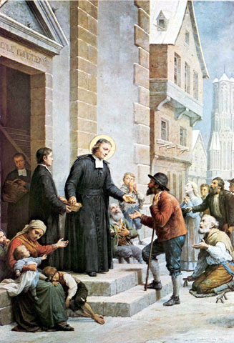
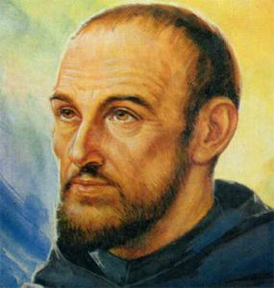
Facing Difficulty
Father Nicolas Barré became his spiritual advisor to help him understand the direction of his vocation.
De La Salle’s decision:
He resigned as canon.
He gave away all his money buying bread for the poor.
He would now trust in Divine Providence.
Notes:
Fr. Nicolas Barré (1621-1686) had founded a group of nuns, Infant Jesus Sisters, in Rouen and had advised Fr. Roland with the task of creating the Sisters of the Holy Child Jesus. When De La Salle was trying to navigate the friction between the needs of his family and the needs of the teachers, Fr. Barre encouraged him to move in with the teachers.
He now sought his advice with how to balance the expectations of his personal work and the needs of the teachers. De La Salle was wondering who is his priority and what direction God was calling him towards. The teachers were also questioning his loyalty as they had given their lives to this school endeavor but De La Salle had only given one part of his life.
De La Salle decided to give himself completely to the teachers and the schools. He bought bread for all of the towns people were starving during a famine. During that time, he gave away the rest of his inheritance which was about $400,000. De La Salle and the teachers would trust that God would provide for all of their future needs.
Possible lesson idea: Direct students to https://www.lasallian.ai/ and ask them to look up what de la salle said about poverty or divine providence.

Slide 17
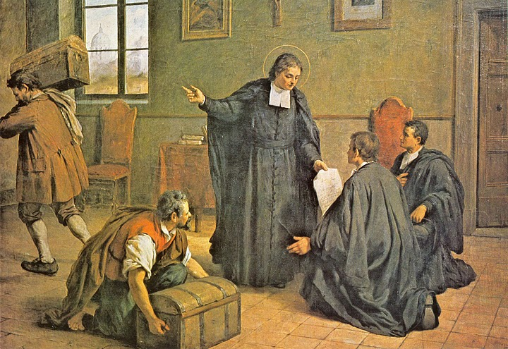
Heroic Vow
Difficulty
Schools were now excellent educational institutions and towns across France were writing to De La Salle to ask for him to send brothers to start schools in their towns.
Financially and legally they were struggling and it was uncertain if the schools would be able to remain open.
Notes:
As schools became more organized and the teachers better at teaching the demand for them increased. De La Salle considered each request and if he had two brothers to send he would often say yes. He refused to send only one Brother because he felt the demands were too much for one person. He would send them with a box of textbooks and supplies and tell them they would have to beg for money and find donors.
The teachers lived off of donations and sometimes a small salary from the priest in the parish that hosted the school. During famines, money became especially tight and people had less to donate. It was also common for there to be arguments between the priest and the brothers because the priest would want to control the school and decide what was taught or which students should attend but De La Salle was clear, it is the Brothers that run the schools not the priests. When these disagreements occurred, the priests would sometimes “forget” to pay the teachers.
Legally they faced troubles with writing masters not happy with the success of these schools and suing to try and shut the schools down. They argued the teachers were not licensed and therefore not legally able to teach. Or the family’s of donors would sue De La Salle to try and get the donation money back arguing that he had coerced the donor.
In some towns the teachers didn’t have enough money to rent a room for the classroom and a home so they lived at the school pushing benches together to use as a bed. Or they would pay for the coal to heat the school but not their homes.
Many of the brothers who took the vows in 1686 had left and many others did as well because they said that the life was to difficult.

Slide 18
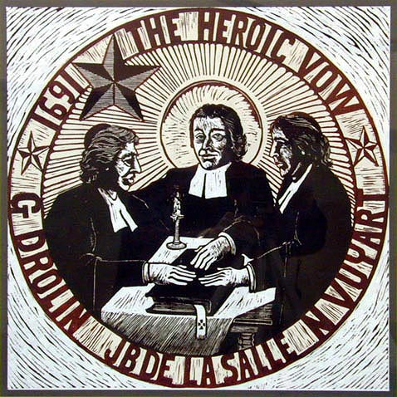
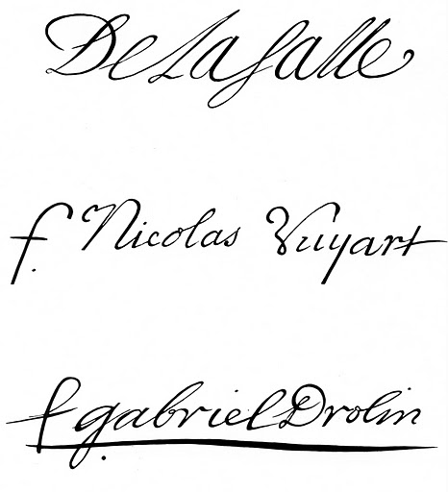
Heroic Vow
Facing Difficulty
De La Salle committed to supporting the teachers and building their community. He also knew it would take more than just himself in order for the schools and teachers to survive.
In 1691, De La Salle, Brother Nicolas Vuyart and Brother Gabriel Drolin take the Heroic Vow.
Notes:
De La Salle knew the life of the teachers was incredibly hard and the only way they could do the work is if they stayed in community with each other. But this was easier when they all lived together, now that they were across France now do they stay connected? DLS would travel to each community even though he was sick and would write letters to each of the Brothers once a month. He knew, only together could the teachers do this work and De La Salle was committed to strengthening the community to support the teachers.
The heroic vow was done secretly, DLS asked his two closest/most committed brothers to take a life time vow that no matter what happens they will work to keep the schools open for the rest of their life. DLS wanted this to be done secretly so that it didn’t seem like he had favorites or alliances. All three hand copied the vows and signed each copy. We only know about the vows because Gabriel Drolin kept his copy of the formula Gabriel Drolin and he shared it after De La Salle’s death.
On their signature, De La Salle wrote his name as it was because he was a priest, the f. in front of Nicolas and Gabriel’s name stands for frère (brother in French). No one actually knew about the vow until after DLS died because he never mentioned it. Vuyart will end up leaving the Brothers to start his own schools and Drolin will be sent to Rome to try and open schools there and didn’t make it back until after DLS died. We have a copy of these vows because of Drolin.

Slide 19
Heroic Vow
Most Holy Trinity, Father, Son and Holy Spirit, prostrate with the most profound respect before your infinite and adorable majesty, we consecrate ourselves entirely to you to procure with all our ability and efforts the establishment of the Society of the Christian Schools, and in the manner which will seem most agreeable to you and the most advantageous to the said Society.
And, for this purpose, John Baptist de La Salle, priest, I Nicolas Vuyart, and I Gabriel Drolin, from now on and forever until the last surviving one of us, or until the complete establishment of the said Society, make the vow of association and union to bring about and maintain the said establishment, without being able to withdraw from this obligation, even if only we three remained in the said Society and even if we were obliged to beg for alms and live on bread alone.
In view of which we promise to do, all together and by common accord, everything we shall think in conscience, and regardless of any human considerations, to be for the greater good of the said Society.
Done on this 21st of November, Feast of the Presentation of Our Lady, 1691
Notes:
Lesson ideas: Ask students to compare the words of the heroic vows and the vows made at the first general assembly in 1694 on the next slide. Let them try to figure out why these are considered heroic.

Slide 20
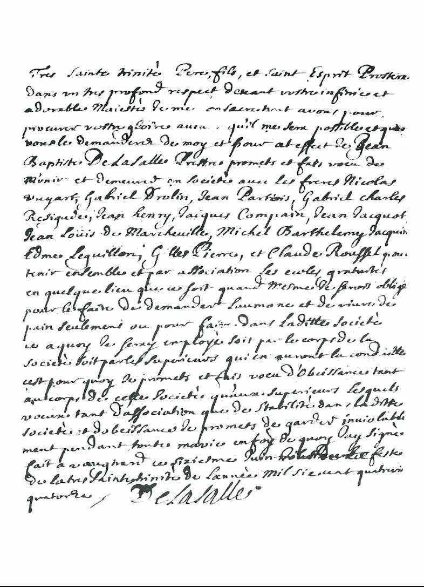
June 6, 1694
… And for this purpose, I John Baptist de La Salle, priest, promise and vow to unite myself and to remain in society with . . . To keep together and by association gratuitous schools wherever they may be, even if I were obliged to live on bread alone, or to do anything in the said Society at which I shall be employed, whether by body of the Society or by the superiors who will have the government thereof.
Wherefore I promise and vow obedience to the body of the Society as well as to the superiors: which vows of association, as well as stability in the said Society, and of obedience, I promise to keep inviolably all my life.
Notes:
Three years later in 1694, De La Salle invited the principal Brothers to a meeting from May 30 through June 6. At the meeting, they approved the Rule, and then on June 6, they pronounced the first perpetual (lifelong) vows made in the Institute. On June 7, they elected De La Salle as Superior of the Society.
The difference between these vows and the Heroic Vow is the timing. The Heroic vow was made when the schools seemed at their most fragile state, lawsuits were pending and money was tight. De La Salle believed if he asked more brothers to take perpetual vows they would say no. But De La Salle also knew the schools would not be successful if they were not committed. The only way the institute would be successful is together and by association.
Presented here is a text written in its entirety by the Founder. It is a solemn and definitive com­mitment to his twelve Brothers, thus representing a notable and decisive step in the development of the Institute.
De La Salle, Drolin, and Vuyart were the first to make permanent vows and they made them during a period of significant crisis and uncertainty for De La Salle and the early Brothers. Perhaps one motivation was De La Salle's fragile health, which almost led to his death toward the end of 1690. The heroic vow was a secret vow, known only through a copy of the formula kept by Gabriel Drolin.

Slide 21
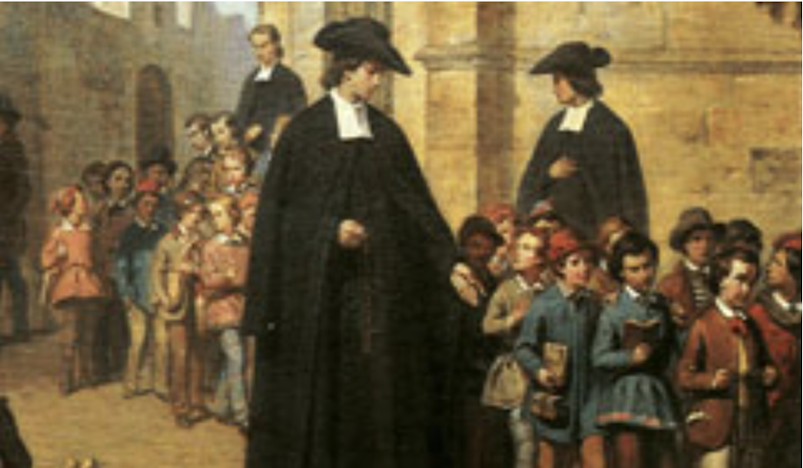
Educational Innovation
Notes:
De La Salle did two things very well. He built the community of brothers, the second was the way he influenced how schools and teachers operated making them more successful.
Look at these two images, the first depicting the way students acted in Nyel’s schools and the second painting showing how the students acted after De La Salle trained the teachers.

Slide 22
Innovation in Education
Gratuitous Schools
Vernacular
Collaborative Schools
Simultaneous Method of Instruction
Practical Instruction
Teaching Teachers
Free school available to all
Learning in the commonly used language
Learning responsibility through chores
Learning alongside
students of different abilities
Learning skills to help get a job
Teachers were trained and used structured curriculum
Notes:
Gratuitous Schools: Up to this moment, the type of education available to a student was determined by their social class (for example, only those with a letter stating poverty could attend charity schools) and most systems of education required payment. De La Salle’s schools were completely free and even if your family could pay money they were not allowed to and they were not allowed to give gifts that may create a system of favoritism. De La Salle taught juvenile delinquents as50 Irish boys whose families had followed James II into exile in France
Vernacular: Up to this moment, students learned Latin and learned in Latin at school. De La Salle actively switched this to teaching in the Vernacular, which at this time and place would have been French. De La Salle argued it is easier for a French speaker to learn to read and write in French than Latin so it will take less time to teach the students. He argued that it was more practical for working people. He also argued that teaching students to read and write in French would help, not make it harder, to learn Latin later on if the person chooses.
Collaborative school: Each student took a turn being responsible for a chore to assist in the classroom. Chores included sweeping the room, leading class prayer, ringing the bell, opening the door, distributing rosaries before mass. The chores helped keep the classroom in order and providing them with a sense of responsibility and helping them develop social and practical skills.
Simultaneous Method of Instruction: Instead of the more popular private tutor style of one on one education, De La Salle taught in a classroom setting. In addition, he would have students of different abilities and levels of experience all in the same room to learn. The needs of the town determined the size of the school, it was not uncommon to have 50 students in a class and for there to be 2-3 different grade levels in the same room. The teacher had to teach all the students and keep them engaged so they did not misbehave and they would do this by giving instruction to one grade level while the other grade levels would work on their own materials. The teacher would then instruct another grade level. The students of the different grade levels would help the younger grades learn. A student would learn from their teacher and their classmates. The only time the teacher taught the whole class at the same time was religion lessons. Religion was the last class of the day.
Practical instruction: Most of the schools De La Salle opened were elementary level. Some students would move on to secondary level but most would go get a job. De La Salle incorporated practical lessons to assist meet the needs of the students. In Paris, a school could include lessons on how to make hats or stockings, on the coast students would learn to astronomy and how to tie knots for work on boats. This is different from specialty guilds because these lessons were secondary to their academic lessons but would assist them in gaining stills for work. He also opened Sunday schools that would provide education for kids who had to work during the week. He later opened similar schools for adults who sought an education.
De La Salle was a pioneer in training teachers. At first when he invited the teachers to dinner he taught them the curriculum but this evolved to include lessons in how to teach, how to manage a classroom. He established a school schedule and routine to help teachers be successful. He also wrote a number of textbooks or workbooks to teach spelling and prayers to create an standard order curriculums since there was no such thing as state standards telling a teacher what to teach, he had to teach pedagogy.

Slide 23
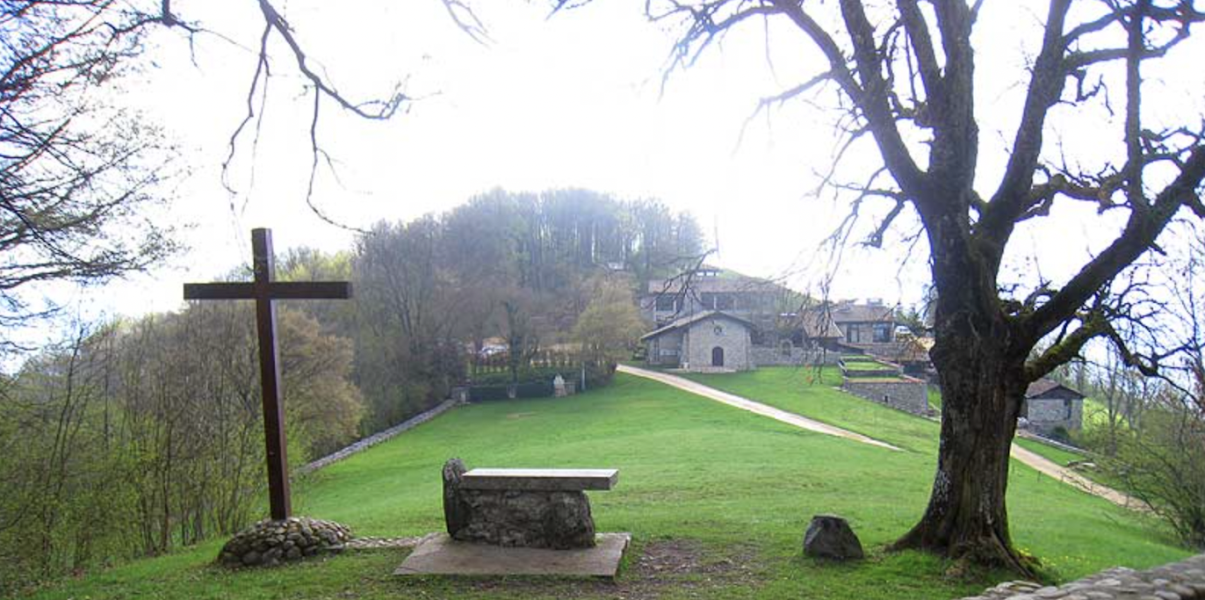
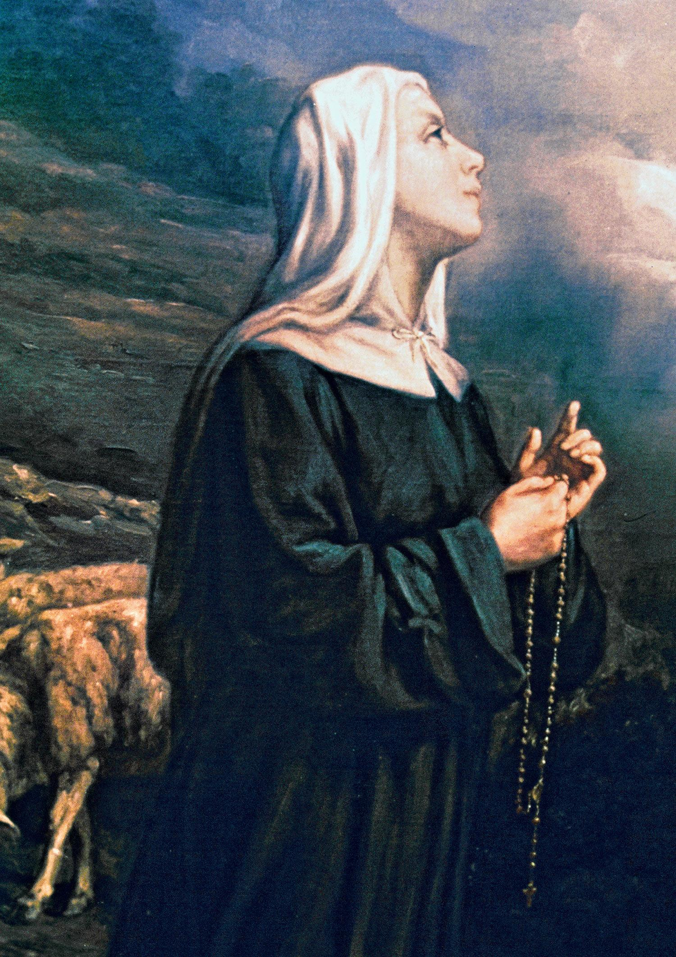
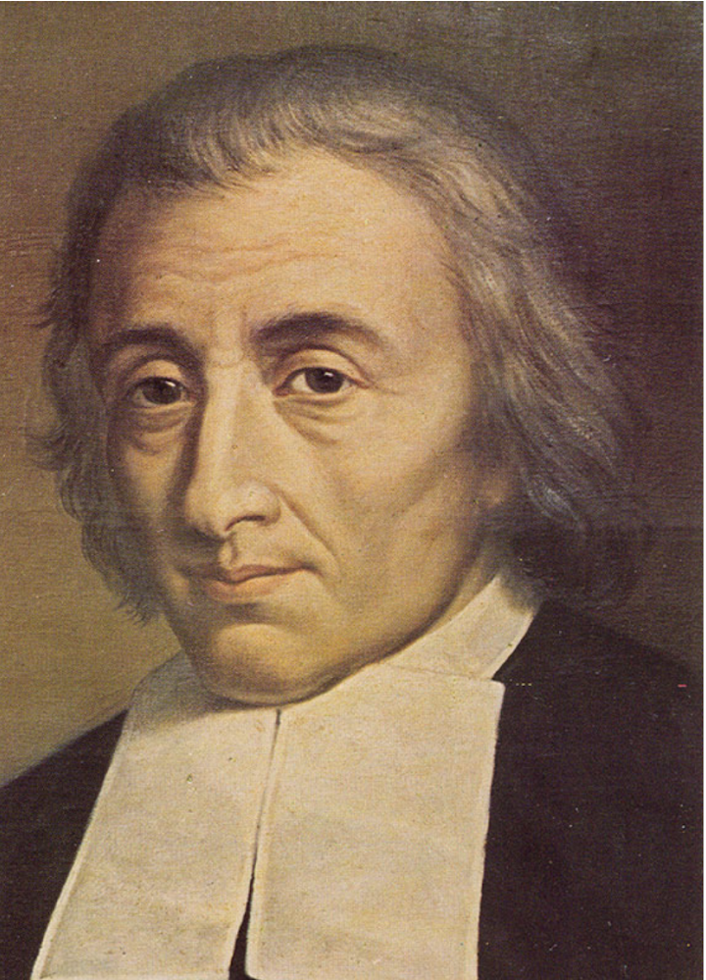
Others Step Up
In 1714, De La Salle became ill and took some time to recover at a retreat center in Parménie. He left Brother Barthélemy in charge while he was gone.
Sister Louise Hours became his spiritual advisor.
Hesitantly, De La Salle returned to Paris and not long after, Brother Barthélemy was elected the Superior General.
Notes:
When De La Salle was 62 and visiting the schools in Grenoble in the south of France, De La Salle dealt another painful attack of Rheumatism. A priest friend recommended he visit a close retreat center in Parménie to recover. This retreat was necessary for physical healing but De La Salle also needed a spiritual retreat as well. The financial and legal problems had caused a lot of stress throughout the years and when times were difficult, it was often accompanied by a lot of arguments. For example, if money is tight, maybe they should charge tuition and De La Salle would argue with parish priests and often the brothers as well over the best way to run the schools.
One particularly difficult moment causing De La Salle stress was the Clement Affair, which involved a lawsuit brought against De La Salle by Julien Clément, the father of Jean-Charles Clément. Jean-Charles Clément was a 23-year-old priest who approached De La Salle in December 1707 with a proposal to collaborate on a project. De La Salle, with the help of a friend, provided a down payment to buy a property for the school in October 1708 and received permission from the archbishop of Paris. De La Salle, with the help of a friend, provided a down payment to buy a property for the school in October 1708 and received permission from the Archbishop of Paris. In February 1711, De La Salle received letters informing him of a lawsuit initiated by Julien Clément. The lawsuit accused De La Salle of attempting to extort money from Jean-Charles Clément. De La Salle was quickly found guilty because the legal age of majority in France at that time was 25. De La Salle forfeited his down payment and was liable to be arrested. De La Salle gave documents proving his innocence to influential people, hoping for justice. The affair was a severe blow to De La Salle, affecting his reputation and causing significant distress.
De La Salle asked God for clarity of his vocation and how to live his vocation. During this time, the chaplain of the retreat center died and De La Salle considered staying at Parmenie to become the chaplain.
Sister Louise Hours: In her youth, she was a shepherd girl who answered a call from God to rebuild the abandoned monastery at Parménie. She spent 52 years of her life at Parmenie assisting retreatants and was significant in being a spiritual advisor for De La Salle.
As days became months, the Brothers wrote a letter requesting his return to Paris and reminded him of his vows to the Brothers.
Their letter included: “Monsieur, we very humbly beseech you, and we command you in the name and on the part of the body of the Society to which you have vowed obedience, to return to Paris.”
De La Salle still was not certain that he should return to the teachers or that he had the energy to do it well. It was Sr. Louise who pushed him to return. She said. "In no way should you abandon the family God has given you. It is your vocation to work actively. You must persevere in it even unto death, combining as you have up to now the life of Mary and Martha."

Slide 24
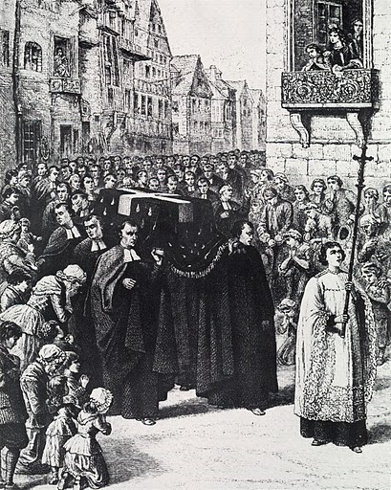
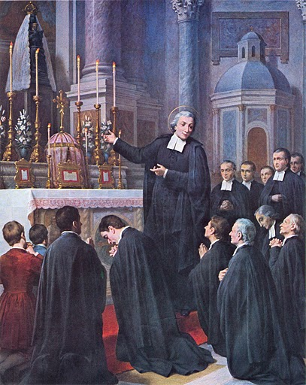
The Last Steps
In 1715, De La Salle moved to Saint Yon and spent a lot of time on bed rest, in prayer, writing books, and saying Mass for the students.
De La Salle died on Good Friday, April 7th 1719.
Notes:
St. Yon was located just outside of Rouen. It was a large property of 16 acres and it included a retreat center for brothers and a novitiate. De La Salle loved St. Yon and wrote the Meditations for the Time of Retreat while there. De La Salle received permission from the bishop to open a boarding school there and when the government saw the successful teaching, the parliament asked De La Salle to open a juveniles detention center at St. Yon. Both brought in a stable income to help fund the novitiate and teacher training school.
One of the requirements of the Bishop was that the Brothers take the students to mass on Sunday. De La Salle disagreed as he did not think it wise to take the students from the detention center off campus. DLS instead said mass in the chapel on campus. The parish priest accused De La Salle of lying about the terms of their contract. The Archbishop stripped De la Salle of his ability to perform sacraments in March 1719, a couple weeks before De La Salle Died.
Towards the end of his life, he was injured when a door fell on him. It caused him extreme head pain, erratic speech, and some loss of consciousness. He was confined to bed rest. The brothers prayed around him and he received the sacraments of last rites (from the same priest who accused him of lying on the terms of his contract). He died at 4am.
The next day, his body was processed through the street and he was buried in a side altar of St. Sever Church at the insistence of the same priest

Slide 25

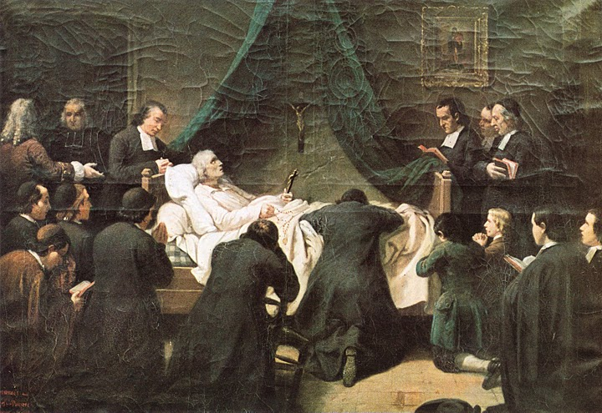
“God, who conducts all things with wisdom and sweetness, and who does not force the inclination of men, wished to employ me completely in the work of education; but He did it imperceptibly and in a long-drawn-out way, in such wise that one commitment led to another without my having foreseen it at the start.”
His last words were “I adore the guidance of God in everything concerning me.”
Notes:
The book holds a photograph of the only painting done in his lifetime (it was painted right after his death). All of our images of De La Salle are based on that painting and written descriptions about him. The original painting was lost and all we have is a photo of that painting.
Just before he took the perpetual vows with the 12 brothers in 1694, he wrote “Memoir on the Beginnings” in which he wrote this first quote.
The second quote was his last words and his response to Br. Barthelemy who was asking if he was suffering (dealing with pain).
Discuss, what do these two quotes teach us about De La Salle’s vocation? What can it teach us about our own vocations?
From page 17 of the book: Vocation is a calling or an invitation from God to a personal relationship with God. The vocational path will look differently for each person, but all share in a common call to God’s love and serving others.

Slide 26
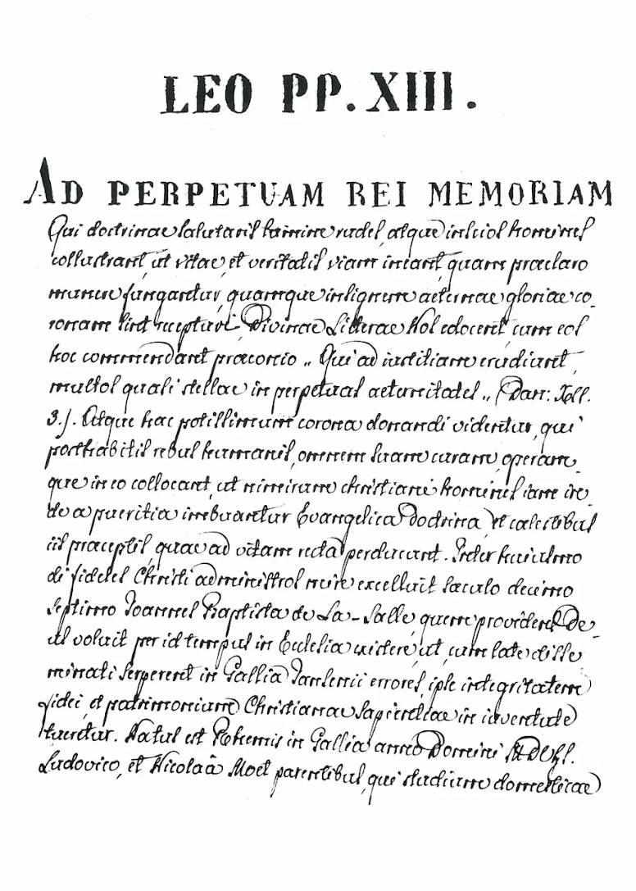
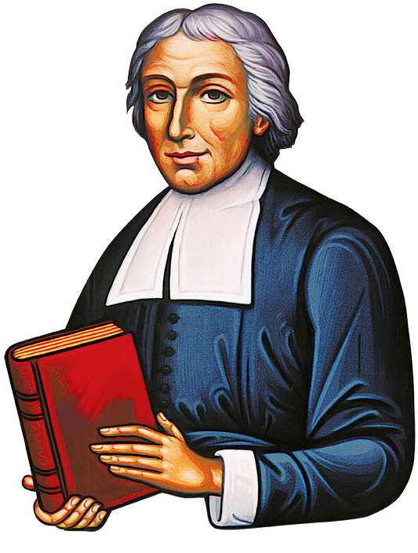
Canonization
In May 1840, Brother Philippe started the process for the cause of De La Salle’s canonization.
On April 22, 1842, Pope Gregory XVI declared De La Salle Venerable in that he had a reputation for sanctity.
De La Salle was beatified by Pope Leo XIII on February 19, 1888 and received the title blessed.
Notes:
The brothers didn’t exactly wait until 1840 to start this process. Immediately after De La Salle’s death, Br. Barthelemy gathered testimonies from clergy who knew DLS. They gathered items that belonged to him and preserved them. Br. Bernard wrote a biography and got the approval from DLS’s family for the book. And they published any of DLS’s works that had not already been published. They also asked Canon Blain to write on the life of De La Salle almost as an explanation or argument for De La Salle to be considered a servant of God.
A couple things slowed down the process. The first was the chaos of the French Revolution and the second was the Catholic Church. At the time Urban VIII (1623-1644) canon law forbade the recognition of a Servant of God until at least 50 years after his death unlike the 5 years today. There were also two popes (Clement XIV and Pius VI) in the 18th century who held no canonizations.
Br. Philippe, was elected superior general in 1838. He submitted De La Salle’s writings on Meditations and Meditations for the time of retreat as well as the letters he wrote to brothers for his cause.
April 22,1842 a pontifical decree recorded his “reputation for sanctity”.
FYI: On September 6, 1846 the diocesan investigations in Rheims, Paris and Rouen were canonically approved. The inquiry into the writings of the Servant of God were then conducted over a period of five years under the direction of Cardinal Lambruschini (the “Proponent” of the Cause) with the cooperation of Cardinal Gousset. On January 10, 1852 the Congregation of Rites announced the orthodoxy of the letters in the Founder’s handwriting, the only writings that the Archbishop of Rheims believed could be affirmed absolutely authentic.
Feb. 19, 1888, this is a Brief of Pope Leo XIII for the Beatification of "Venerable" John Baptist DE LA SALLE
The first miracle for De La Salle’s beatification was a 20 year old nurse, Vittoria Ferry from Orleans, France. In 1832, she was working in a hospital when she was attacked by a madwoman who had knocked her down, stepped on her and stabbed her many times. Since that attacked, she suffered constant pain – terrible fevers, vomiting of blood, a strange swelling of the body and loss of consciousness. She had been bled more than two hundred times by physicians. People wondered how she survived. In 1844, one of her acquaintances suggested that she invoke John Baptist de La Salle. She read about him and prayed his intercession. After doing so, during the night she heard a voice saying, “You are cured!” She saw a heavenly vision…and, in a single bound, she was out of her room; she ran to the church, where she knelt in thanksgiving. The two other persons in whose favor miracles were performed and whose witness warranted canonization did not enter the picture for another twenty-five years.
The second miracle occurred to Brother Adelminiamo who in 1866 ran the school of Saint Nicholas des Champs in Paris. Brother Adelminiamo was stricken with progressive multiple sclerosis. A famous doctor to whom he went to be healed said to him: "My dear Brother, no one is cured of this illness." Seeing no hope in everything said to him, Brother turned instead to his Father and Founder, John Baptist de La Salle. Courageously, he left Paris and had himself taken to the tomb of De La Salle in the city of Rouen. On 5th January 1868, after finishing a novena without any result, the Brother, who was full of faith, began a second novena. Suddenly he was stricken with sufferings far greater than anything he had previously experienced. It was at first thought that he would die but instead found himself instantly cured forever by the intercession of the Venerable John Baptist de La Salle.
The third miracle was for Stefano de Suzanne, an eleven year old boy in 1868. He suffered from a serious form of rickets, his body so bent that his forehead touched his knees. His parents had lost all hope of him being saved but wished him to receive his First Communion before he died. [note: at this time the age of first communion was usually about 12] When the parents spoke of their resignation and sorrow to Cardinal Bonhomme, he said:" If I was in your situation, I would ask the Venerable De La Salle to cure your child. He cured Brother Adelminiamo and he will save and free your son as well.” The boy's grandmother was present and she immediately began a novena. On the third day the boy stated that he believed he would be cured. Gradually the boy's sufferings became less frequent while he continued to say, "Yes, yes, he will cure me at the end of the novena!" Turning to his mother, he said "Get my clothes ready for going to Mass." By the end of the novena the boy felt that he was completely cured. The following day he was received in church to thank God for the cure that he had received.

Slide 27
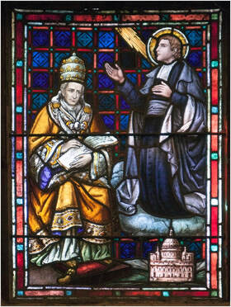
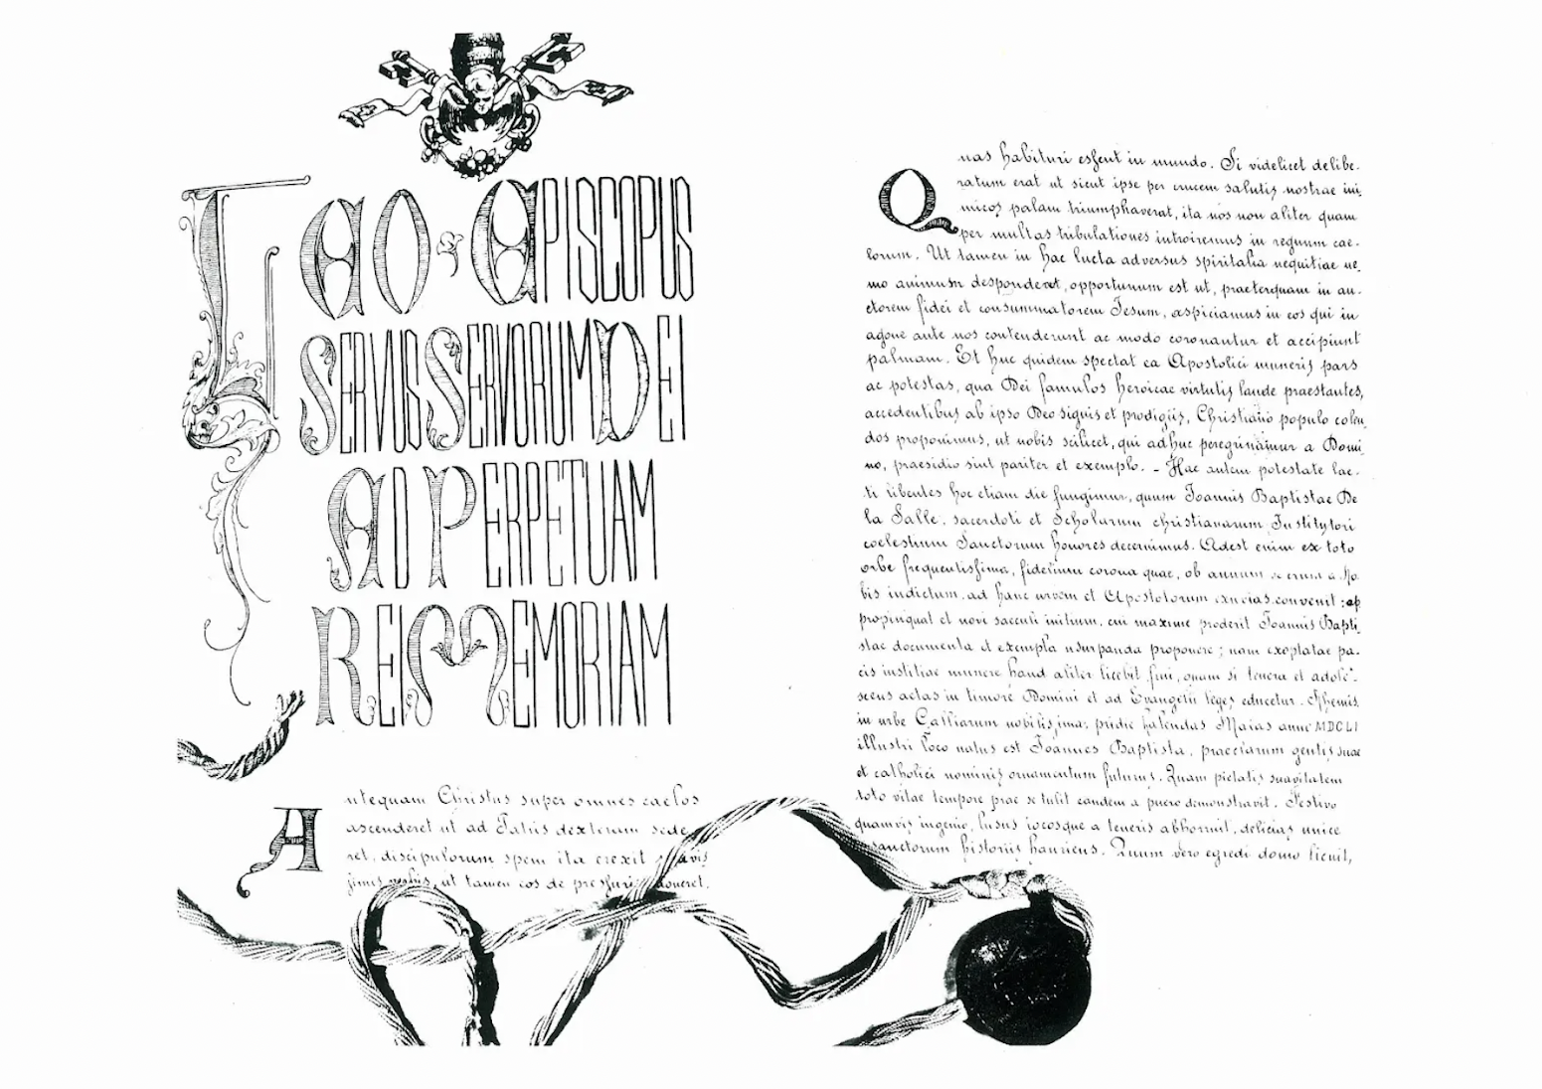
Canonization
On May 24, 1900 De La Salle was canonized by Pope Leo XIII.
De La Salle was declared patron saint of educators by Pope Pius XII on May 15, 1950.
Stained glass window at the Chapel of St. Mary’s College, Moraga
Notes:
The image shows the bull of canonization
Two further miracles that took place in 1889 were eventually recognized by the
Church so that the canonization of Blessed John Baptist de La Salle took place in Saint Peter's Basilica, Rome, on 24th May 1900.
The first miracle was that of Leopoldo Tayac, a pupil of the boarding college in Rodez (France). As Leopoldo was stricken with a serious lung infection and of lesions in the central part of the brain, doctors had given up all hope of any recovery and declared that he would soon be dead. The whole staff of teachers and pupils gathered in the college chapel to pray for his cure through the intercession of the recently beatified De La Salle. When the doctor who was treating Leopoldo received an urgent message to return to the college, he assumed that it was to write the death certificate. To his astonishment, he found Leopoldo completely restored to health.
The second miracle was of Brother Netelmo of the community at Maisonneuve, near Montreal in Canada. Afflicted by an incurable paralysis that allowed no movement at all of the spine, Brother Netelmo could not move in any way at all and suffered grievously. On the 4th May, when the feast of Blessed De La Salle was being celebrated, Brother Netelmo begged him with tears to have pity on him. Suddenly he felt movement again in the paralyzed parts of his body, stood up by himself, and was completely cured.
St. Elizabeth Ann Seton is the patron saint of Catholic Schools, and St. Thomas Aquinas is a patron saint of students and studying.
A possible activity is to ask the students to meditate on window 10 with Br. Camillus Chavez, fsc. https://www.brothercamillus.com/de-la-salle-windows-meditations.html

