Slide 1

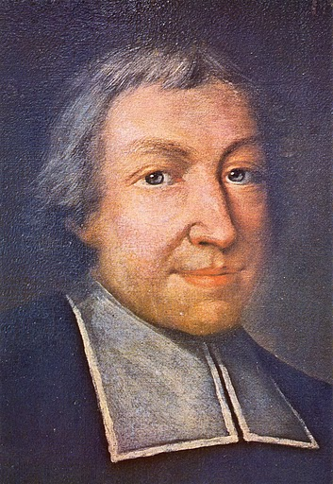
Saint Jean Baptiste de La Salle 1651-1719
Notes:
Before you begin this presentation, consider asking your students why they chose your school and perhaps in pairs they can write their answers on the board. Then suggest the reason for each of these items is because of the traditions of these schools and that each of them could be an example of one of the Lasallian Core Principles. Our school is the way it is because of our traditions stemming from the St. John Baptist de La Salle. Each Lasallian school is a beautiful marriage between our tradition and the unique personality of our students. Each Lasallian School has a lot in common and small differences.
A possible project to help students understand tradition is to ask them to research an ancestor and to write about how this person has impacted them.
The name of De La Salle is first given in English, then in French. We will use the English spelling throughout this presentation.

Slide 2



1. Background
2. Life of De La Salle
3. To be “Lasallian”
4. Lasallian Mission Today

Slide 3
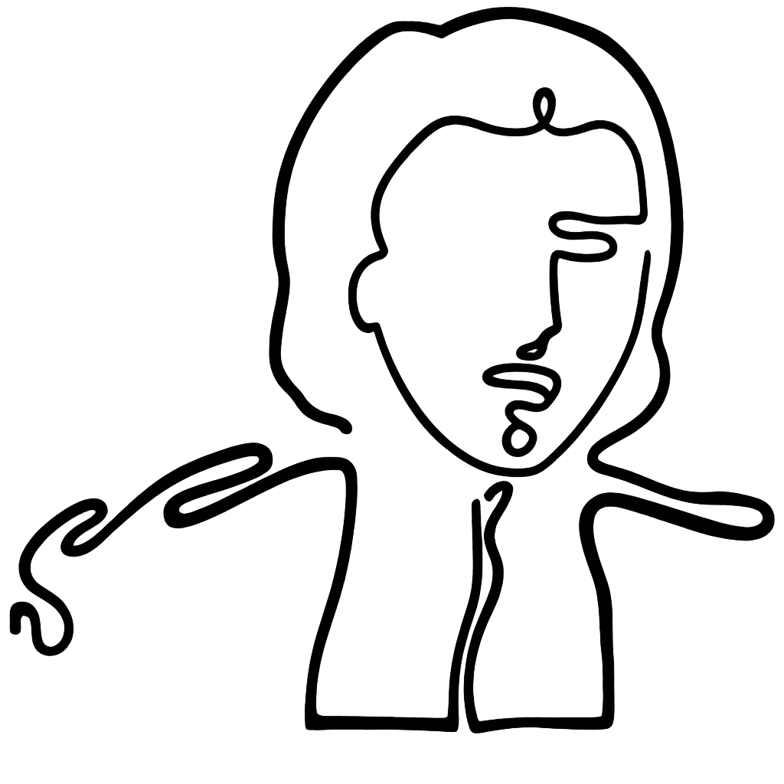
1. Background: 17th Century France
Prepare a path for God so that he can enter your heart.
Meditation 2.1
Notes:
Maybe instead this quote: Do not have any anxiety about the future. Leave everything in God’s hands, for he will take care of you. -Letter 102 to a Brother

Slide 4

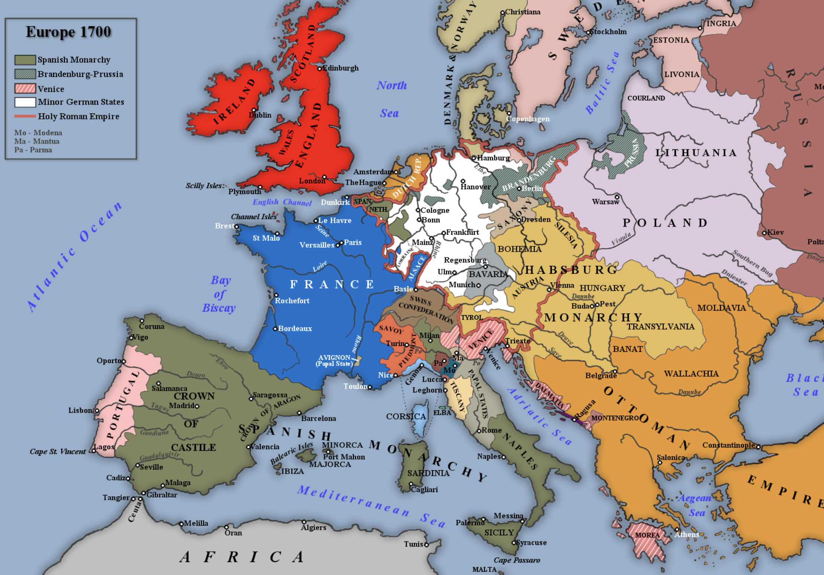
Notes:
For the next few slides, we are going to be looking at France specifically during the years of 1651-1719.
France had almost 20 million people making it the largest country, by population, in Europe.

Slide 5
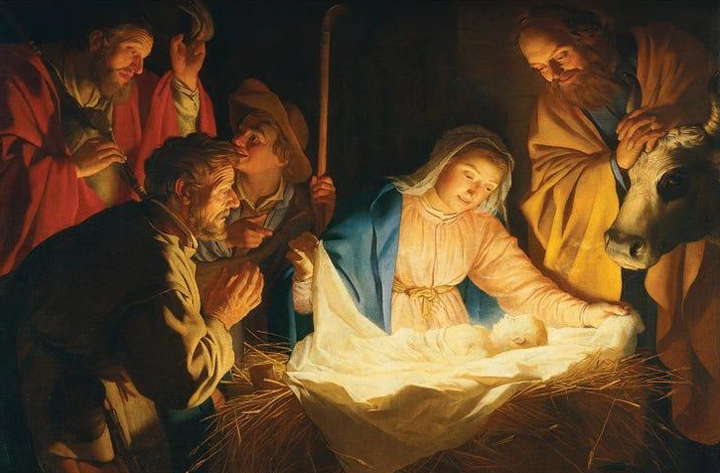
Religious Background
I came so that all may have life and live it more abundantly.
John 10:10
Adoration of the Shepherds
By Gerrit van Honthorst
Notes:
Religiously, France was a Catholic country. The Catholic Church is one type or denomination of Christianity.
Invite students to offer up names of different Christian denominations they have heard of before. Then ask them what all the denominations have in common.
They all believe Jesus is God and came to earth to help all of humanity. In fact, Jesus said he came so that all may have life and live it to the fullest. This is the basis of Christianity and it has inspired Christians, like St. John Baptist De La Salle, to help others live their own lives to the fullest.

Slide 6
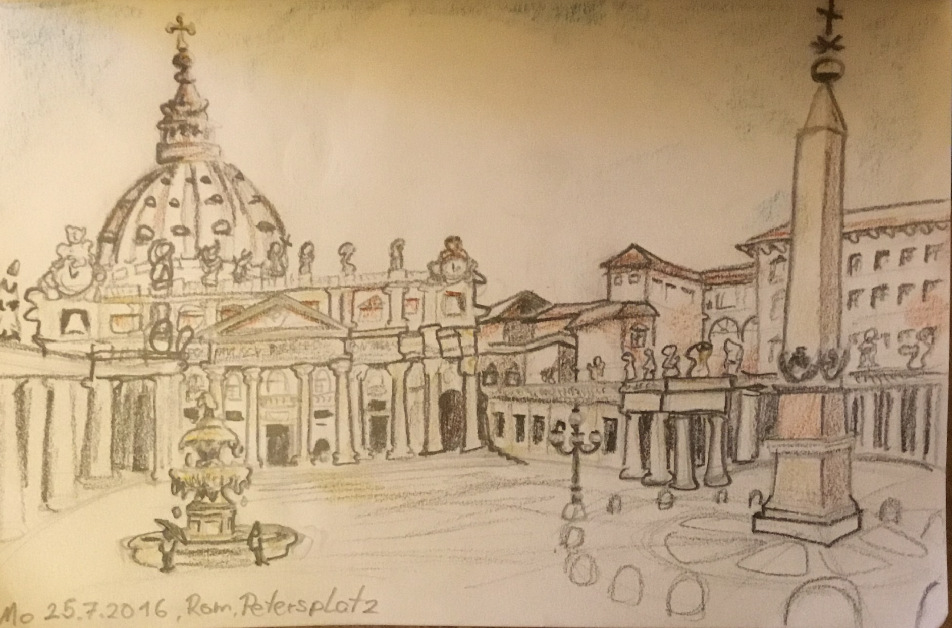
Religious Background
The Holy Roman Catholic Church is led by the pope and the largest of the Christian churches.
In 1651, France was a Catholic country which means the majority of French people were Catholic and it influenced French culture.
At this time, there were a lot of religious changes due to the Protestant Reformation.
Art by Carsten Smithby
Notes:
Pope Innocent X was pope in 1651 when DLS was born and Clement XI was pope when DLS passed away in 1719.
Most French people were practicing Catholics and those who were not would still have been familiar with seeing Catholic Churches, priests and nuns in their daily lives.
Today there are many different Christian denominations but in 1500, there was pretty much only the Catholic Church in the western world and the Orthodox Church in the eastern world. In 1517, Martin Luther nailed the 95 Theses to the door of his church in Germany which led to the Protestant Reformation. This will cause the Council of Trent (1545-1563) within the Catholic church and wars between nations (one example will be the 30 year’s war which will be talked about later).
This time of transition within the Church explains some of the conflict De La Salle would later have with his local bishops and why he would insist on sending two Brothers to start a school in Rome near the Pope.

Slide 7
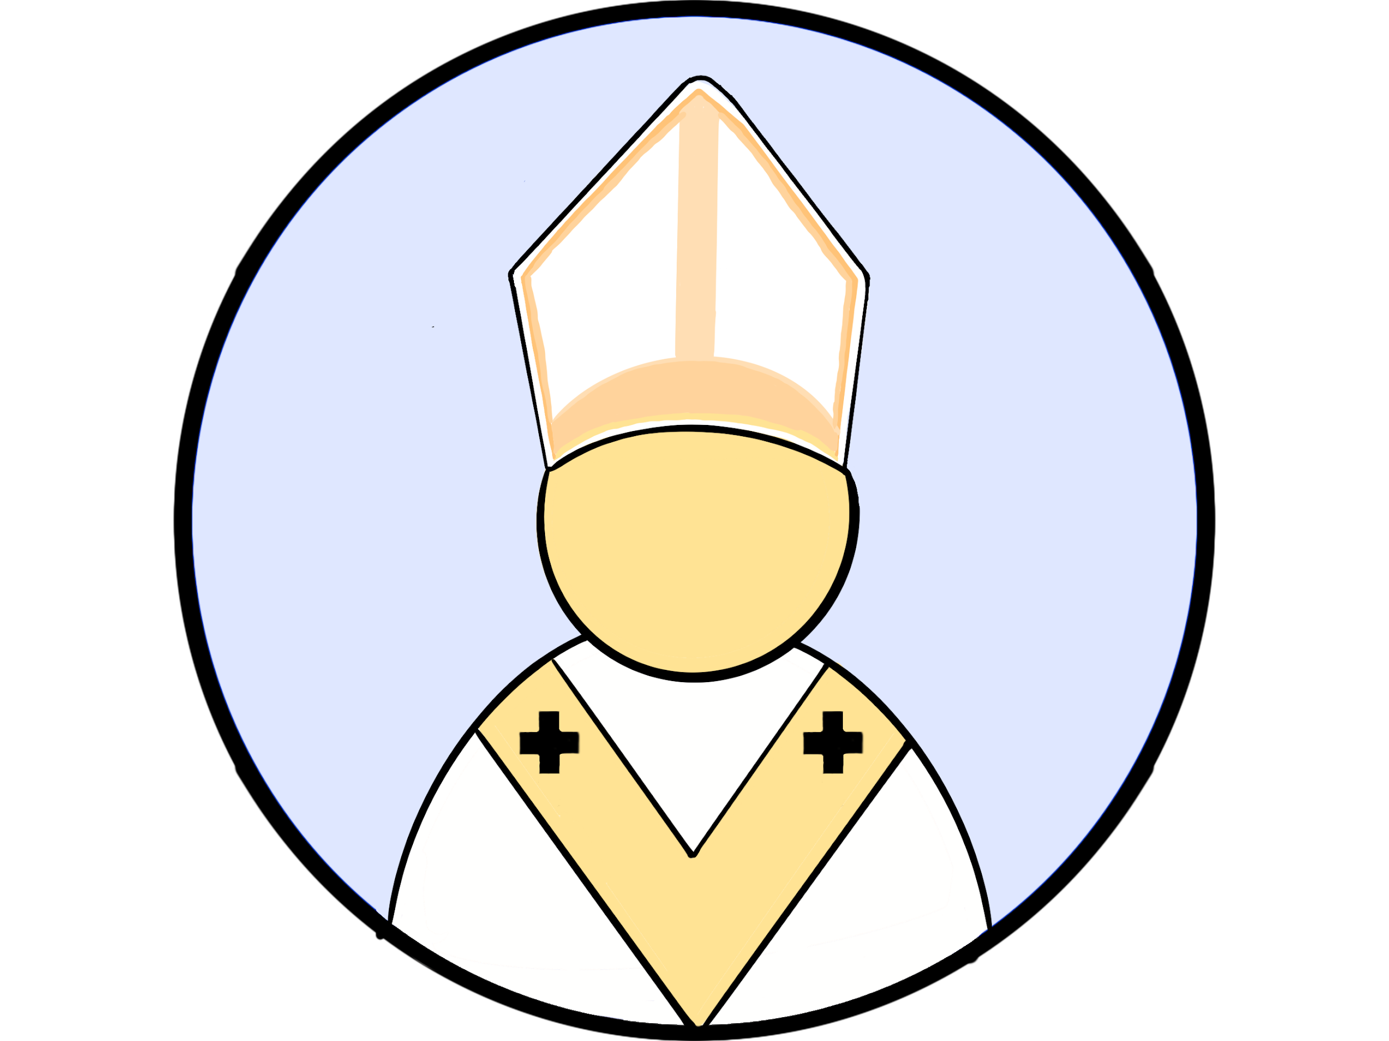
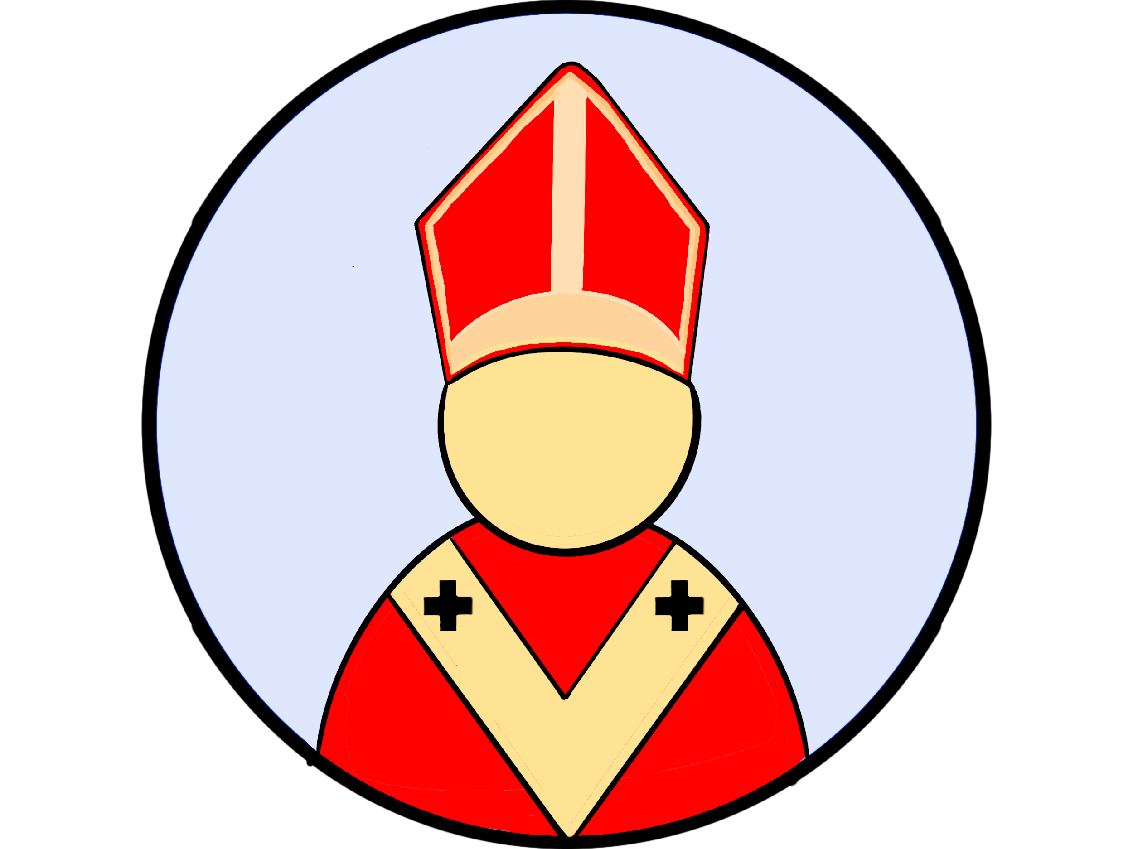
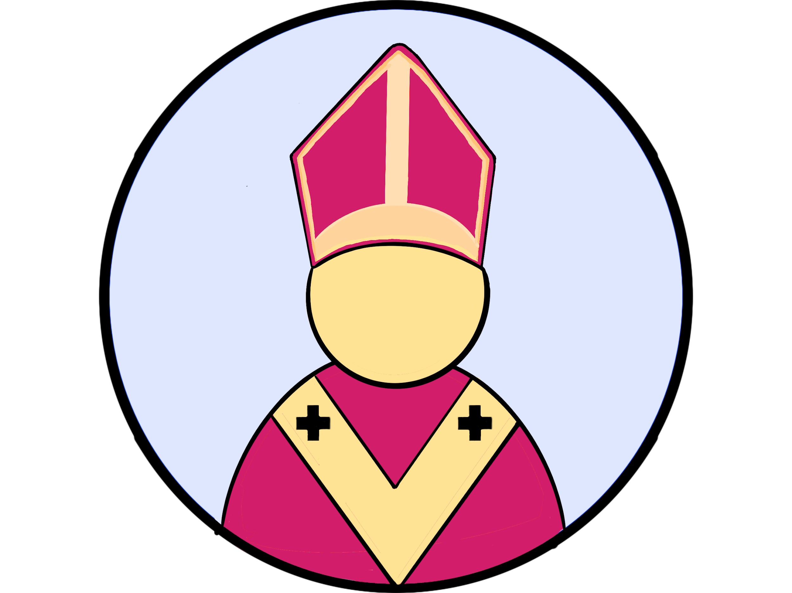
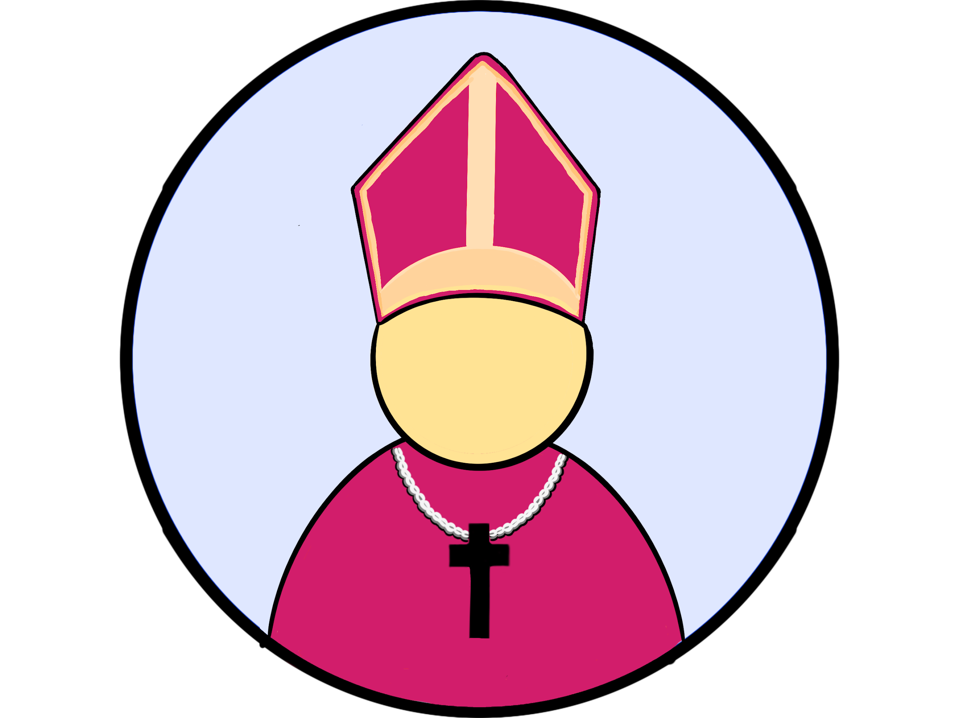
Hierarchy of the Catholic Church
All of these are bishops.
Some bishops have different responsibilities because of their role and title.
Apostolic Tradition
Pope
(Bishop of Rome)
Cardinal
Archbishop
Bishop

Slide 8
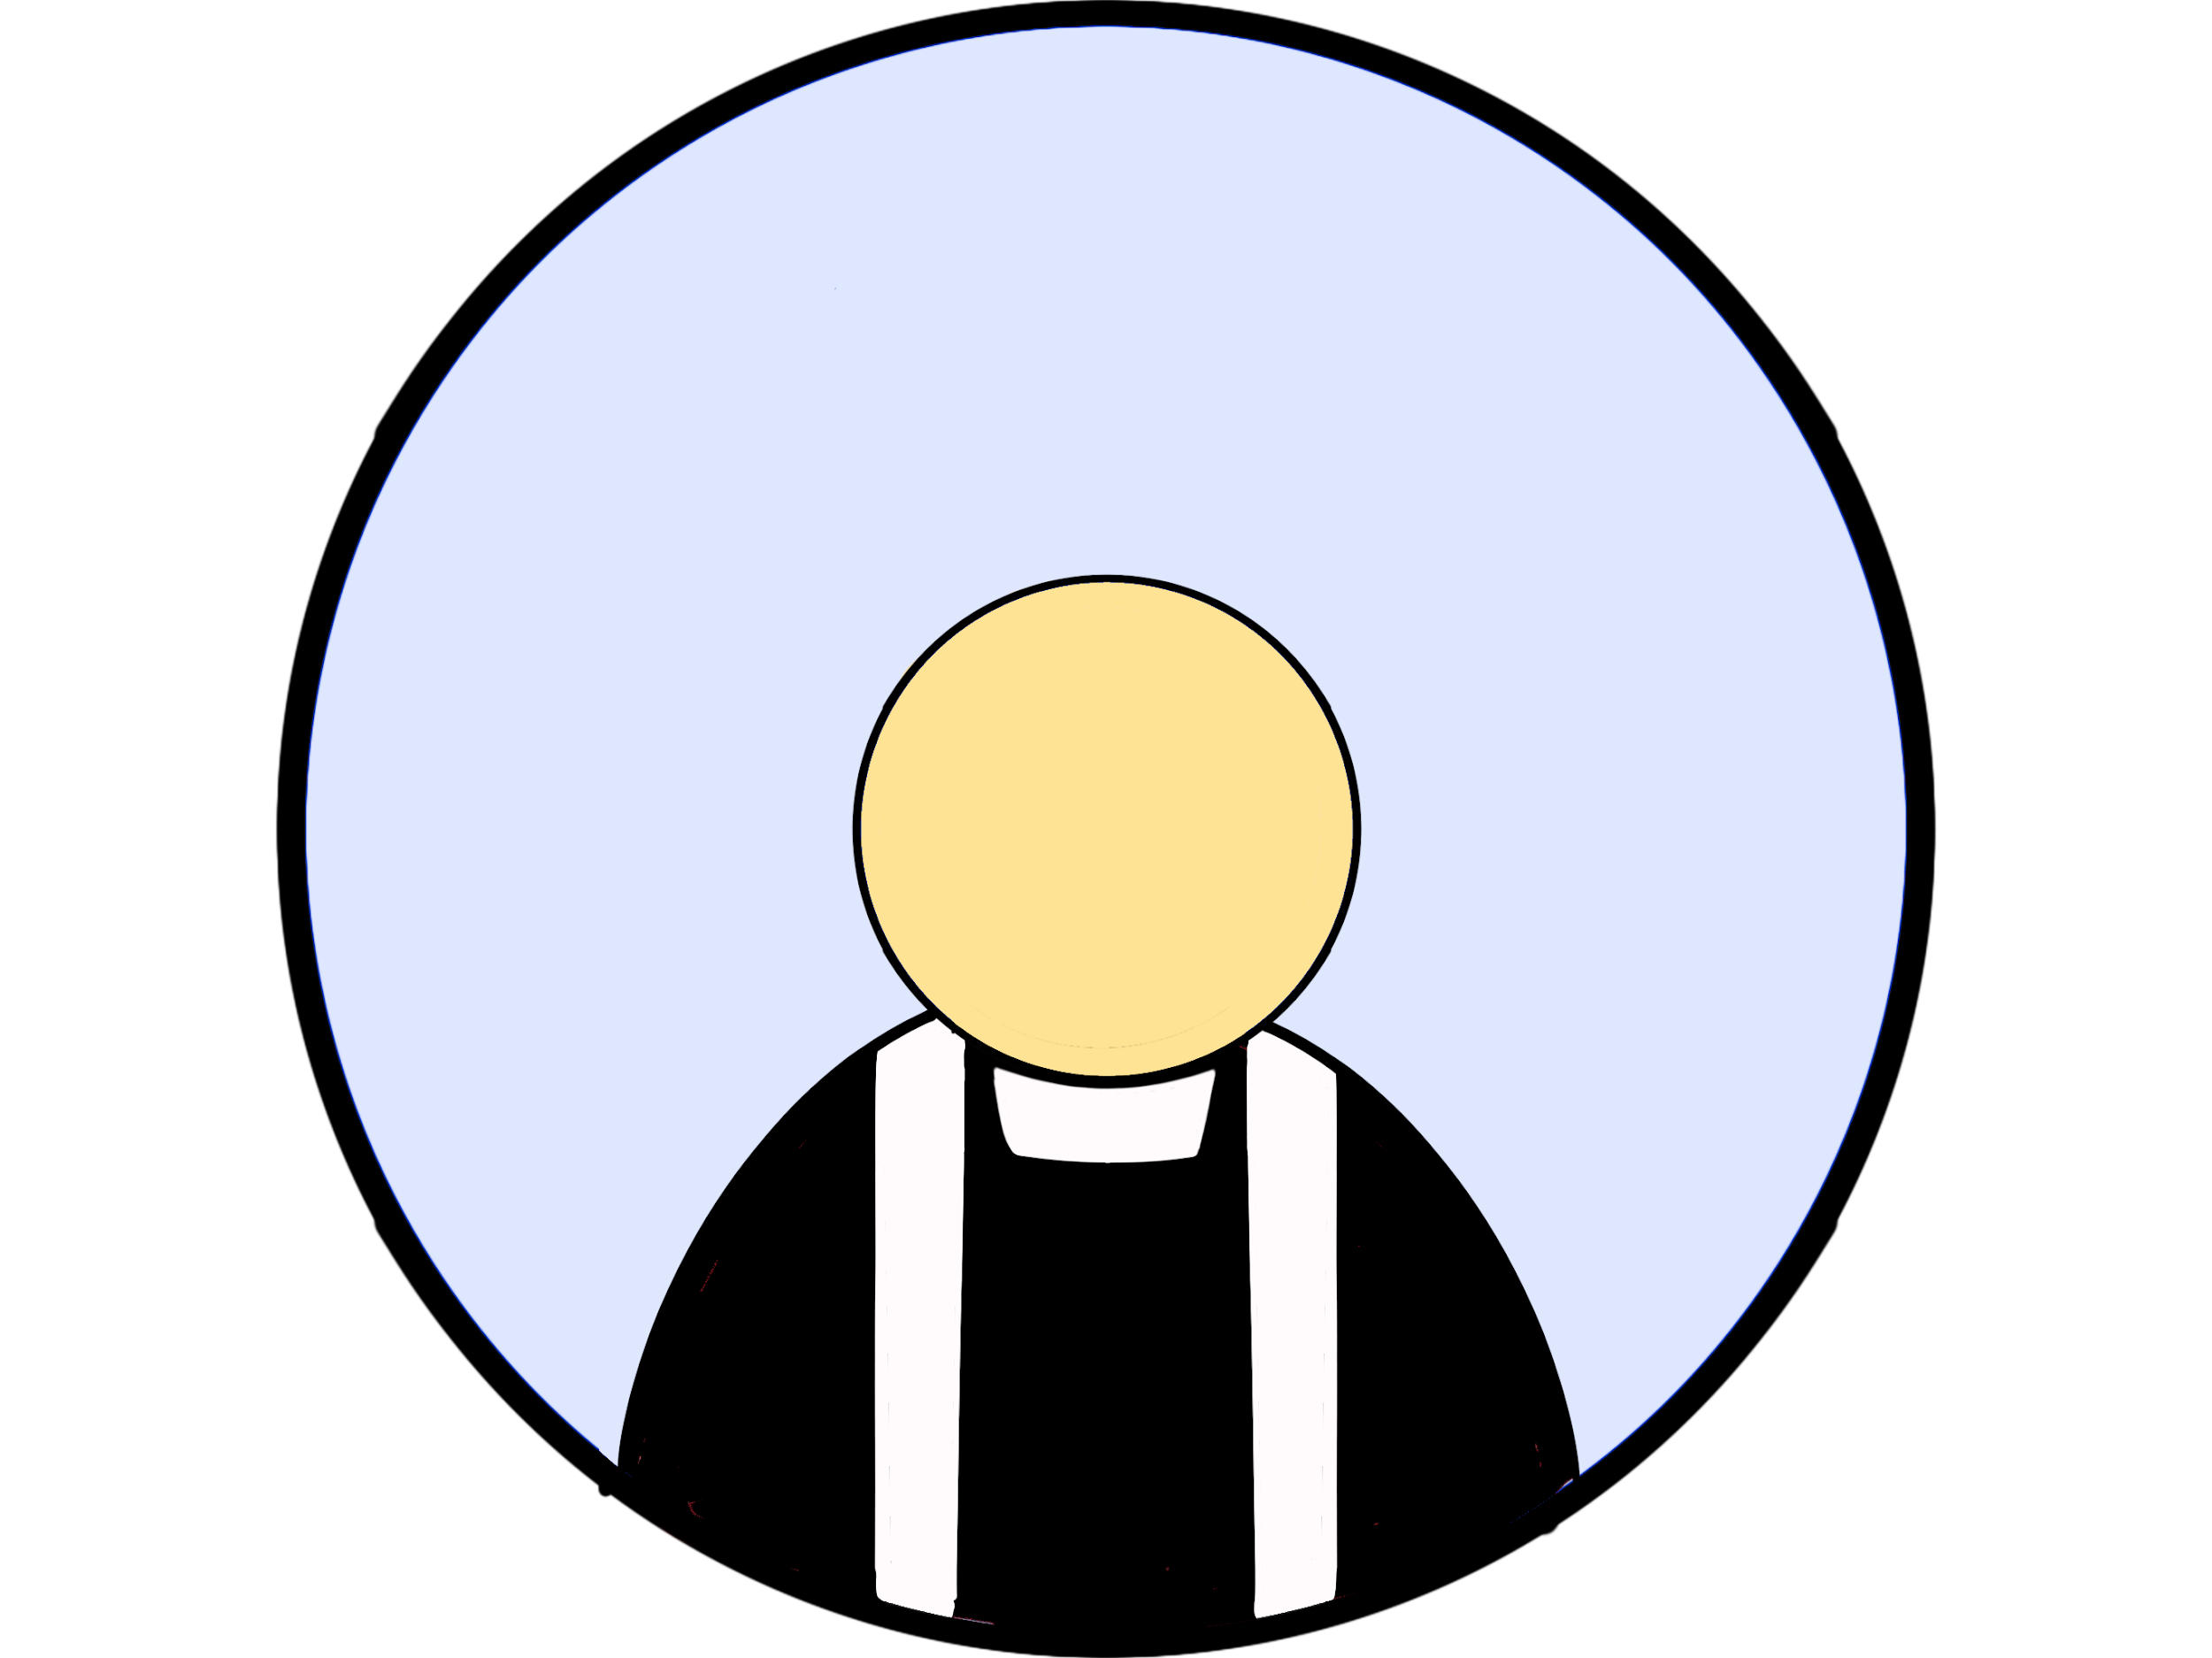
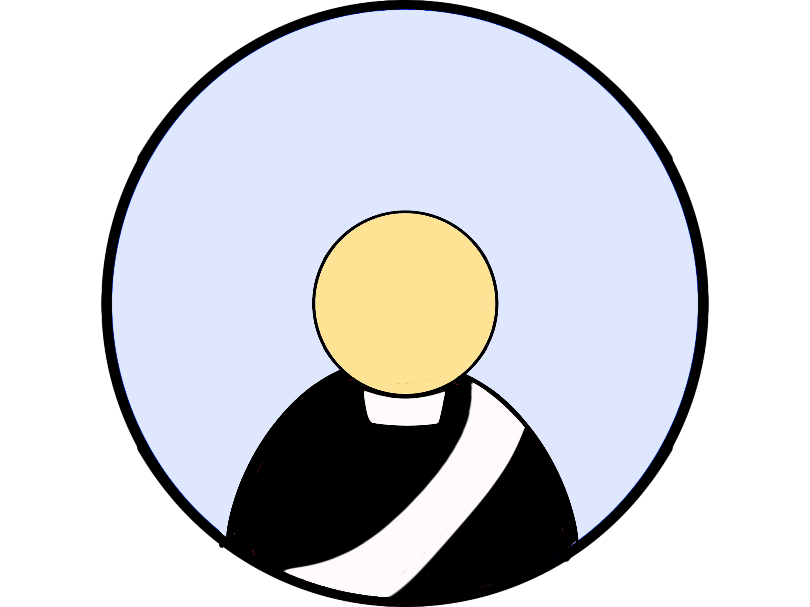
Hierarchy of the Catholic Church
Priests and Deacons - Ordained clergy who aide the bishop
Priest
Deacon

Slide 9
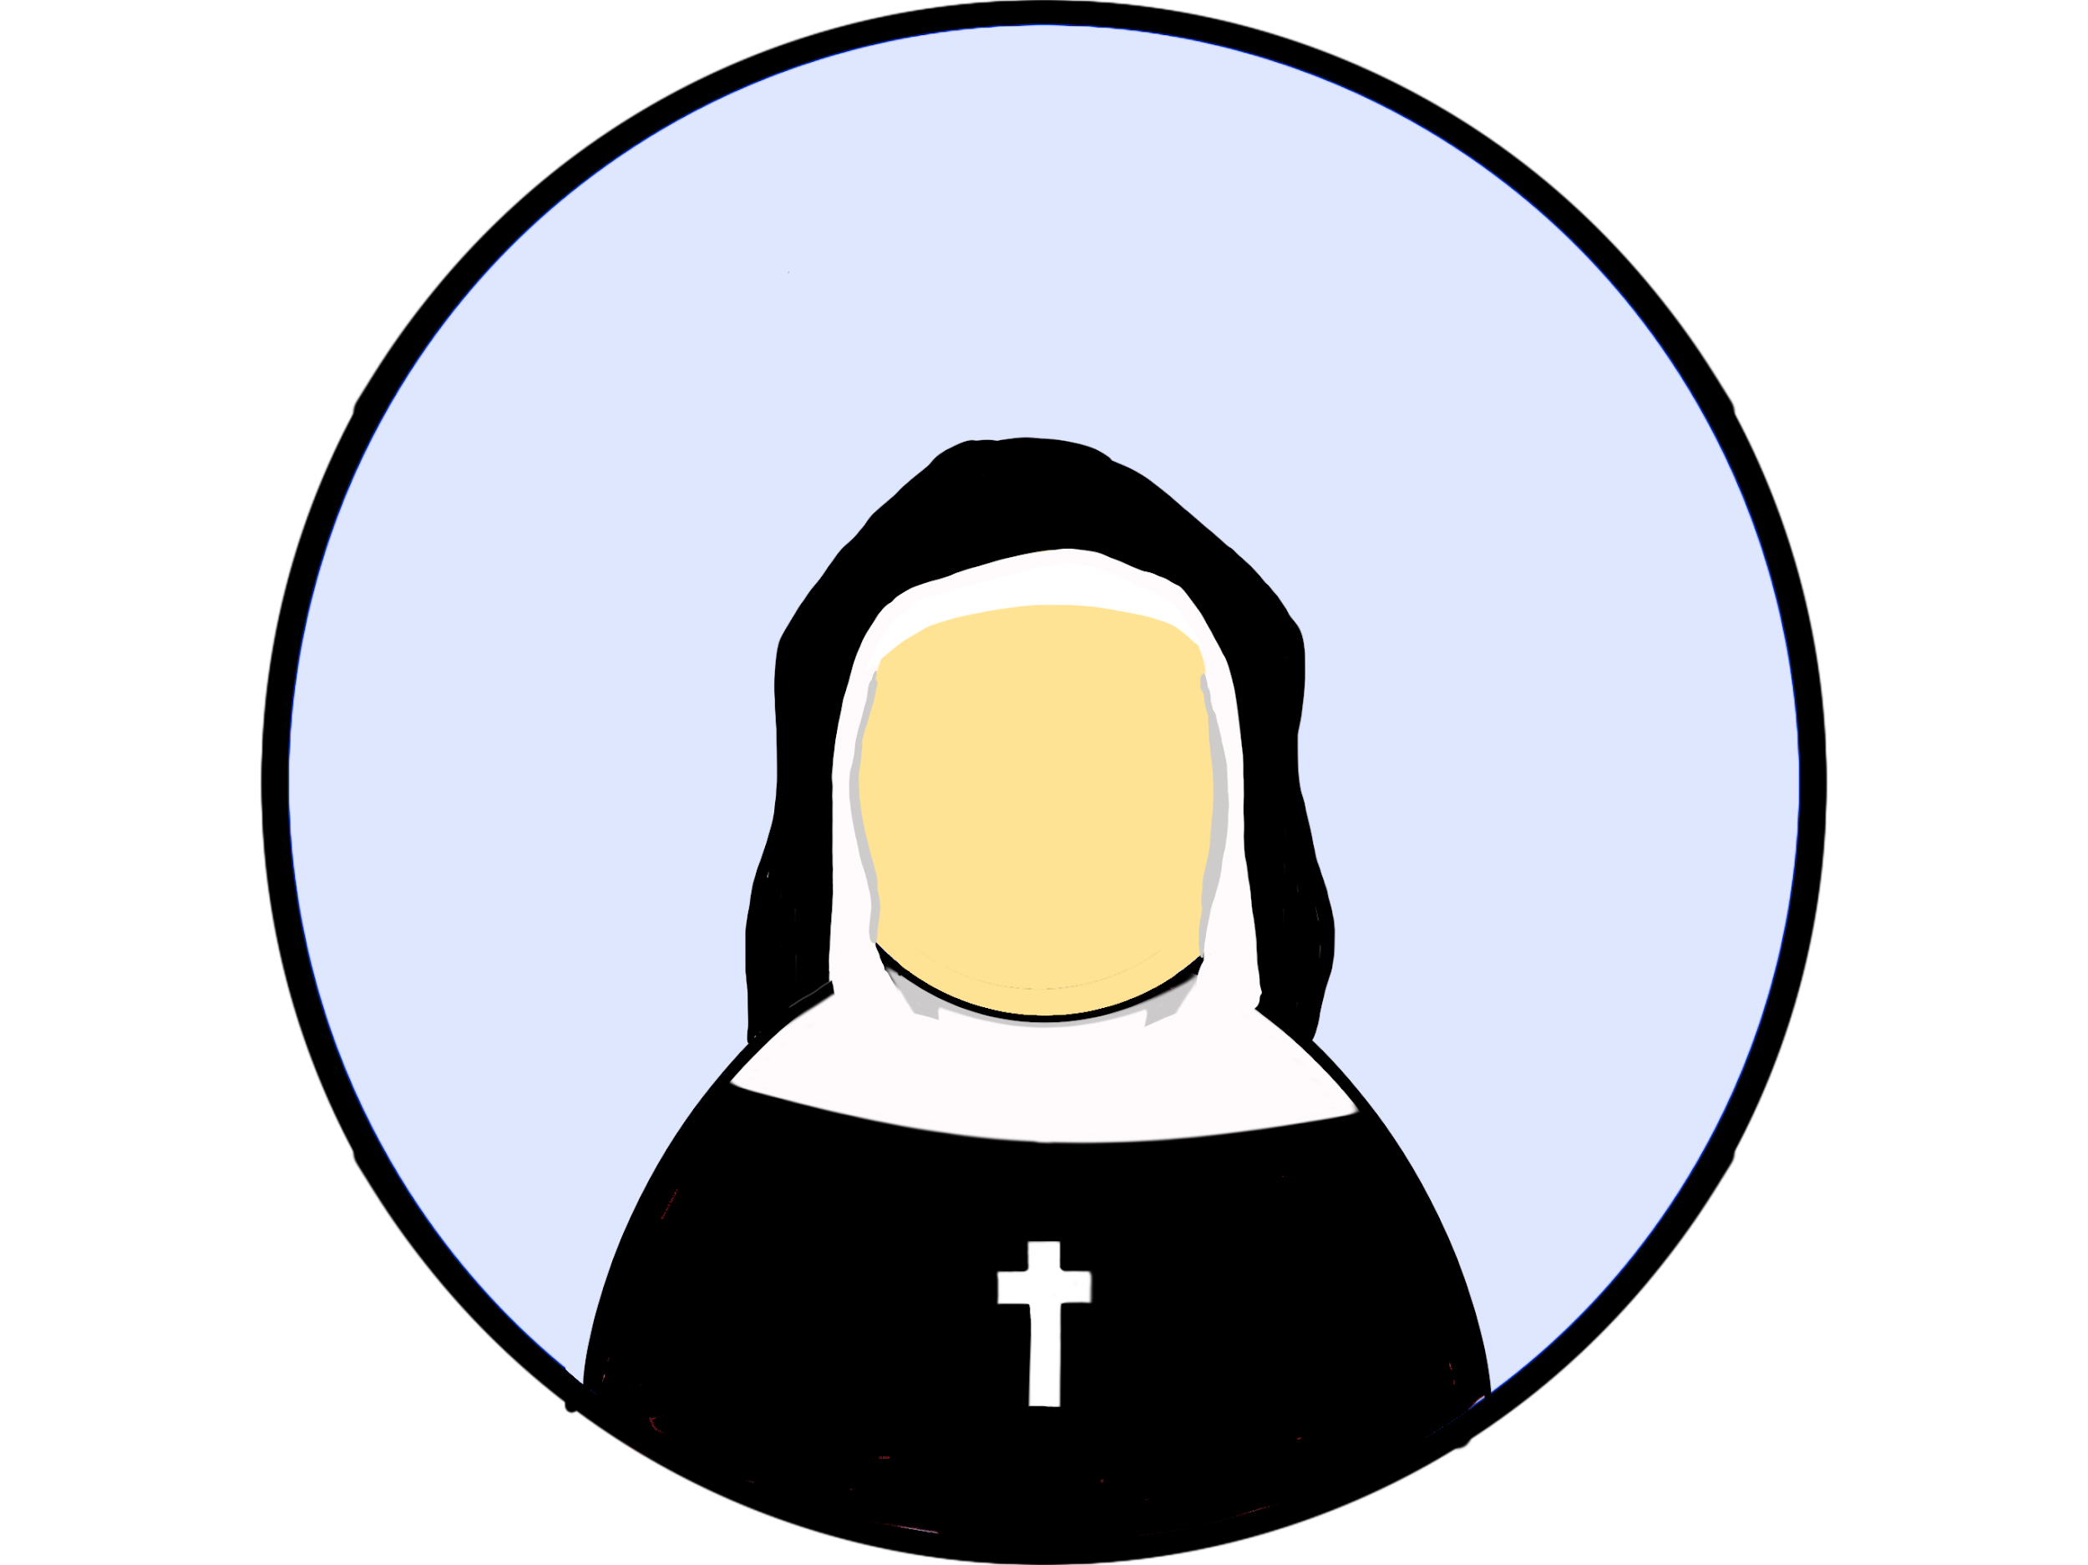

Hierarchy of the Catholic Church
Religious Orders and the Laity (those who are NOT ordained)
Religious
Laity

Slide 10
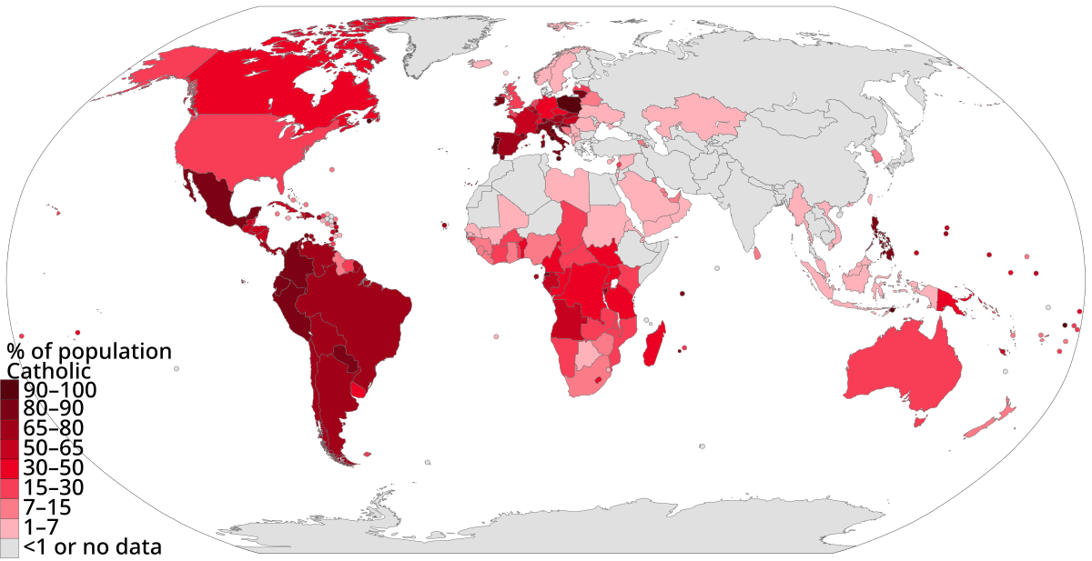
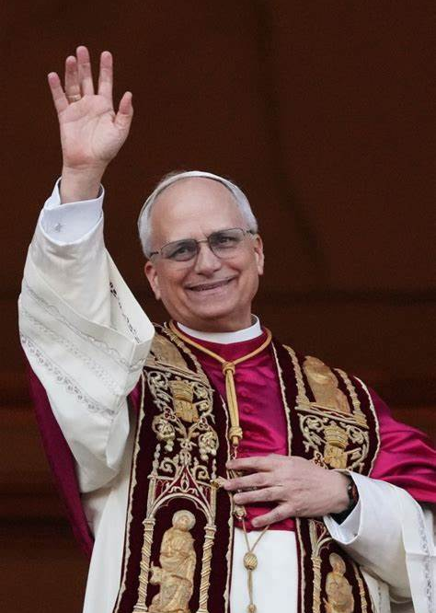
Our Pope
Pope Leo XIV

Slide 11
Our Diocese
Insert picture of your diocese
Insert picture of your Bishop

Slide 12
All baptized faithful are collectively the Body of Christ.
As a body is one though it has many parts, and all the parts of the body, though many, are one body, so also Christ.
1 Corinthians 12:12

Slide 13

What was the Economic Background of France?
?

Slide 14

Social Hierarchy
Clergy (Rich upper class and poor lower class
Nobility (they had property and the king knighted them. This title was inherited or purchased)
Bourgeoisie (middle class, they work and run things, like city council or lawyers, major business owner)
Peasant (farmers, sailors, soldiers)

Slide 15

“
Of the 450 sick persons whom the inhabitants were unable to relieve, 200 were turned out, and of these we saw die one by one as they lay along the roadside. A large number still remain, and to each of them it is only possible to dole out the least scrap of bread. We only give bread to those who would otherwise die. The staple dish here consists of mice, which the inhabitants hunt, so desperate are they from hunger. They devour roots which the animals cannot eat; one can, in fact, not put into words the things one sees… Not a day passes but at least 200 people die of famine in the two provinces. We certify to having ourselves seen herds, not of cattle, but of men and women, wandering about the fields between Reims and Rhétel, turning up the earth like pigs to find a few roots; they become so weak that they have not strength left to seek food. The parish priest at Boult, whose letter we enclose, tells us he has buried three of his parishioners who died of hunger. The rest subsisted on chopped straw mixed with earth, of which they composed a food which cannot be called bread. Other persons in the same place lived on the bodies of animals which had died of diseases”
- Report from the Estates of Normandy 1651
Notes:
https://home.uncg.edu/~jwjones/moderneurope/readings/socialconditions.html
De La Salle was born in 1651 in the town of Rheims. This is the situation the people from his town were experiencing.

Slide 16
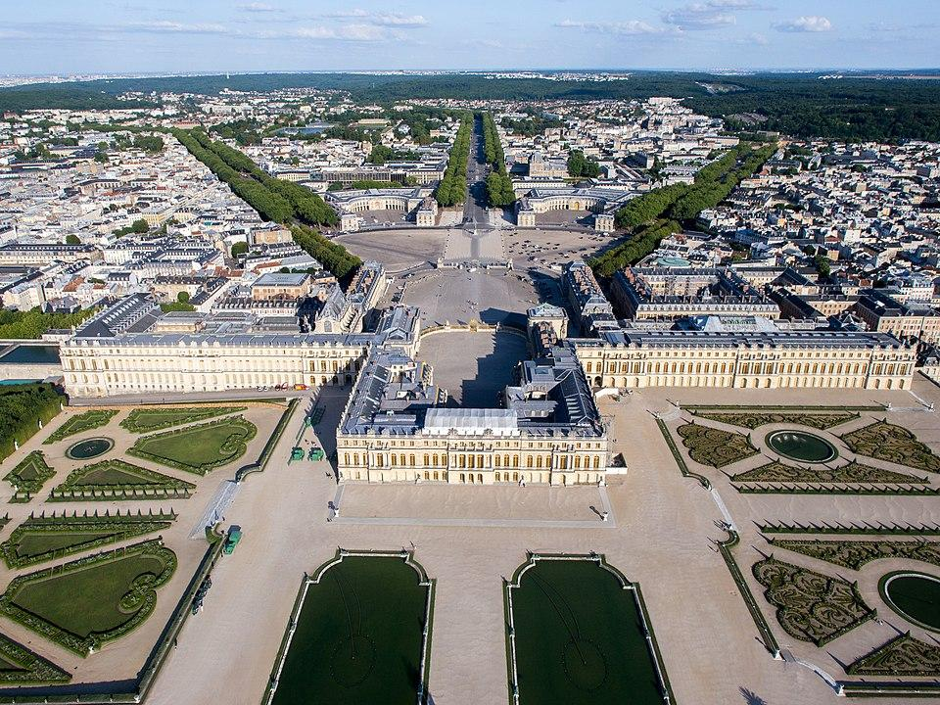
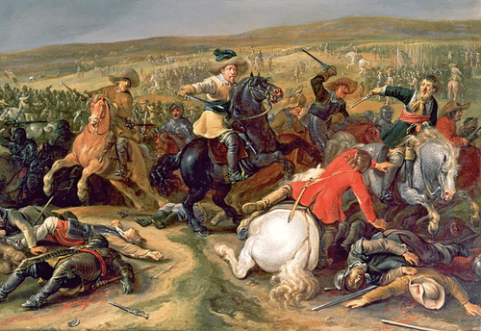

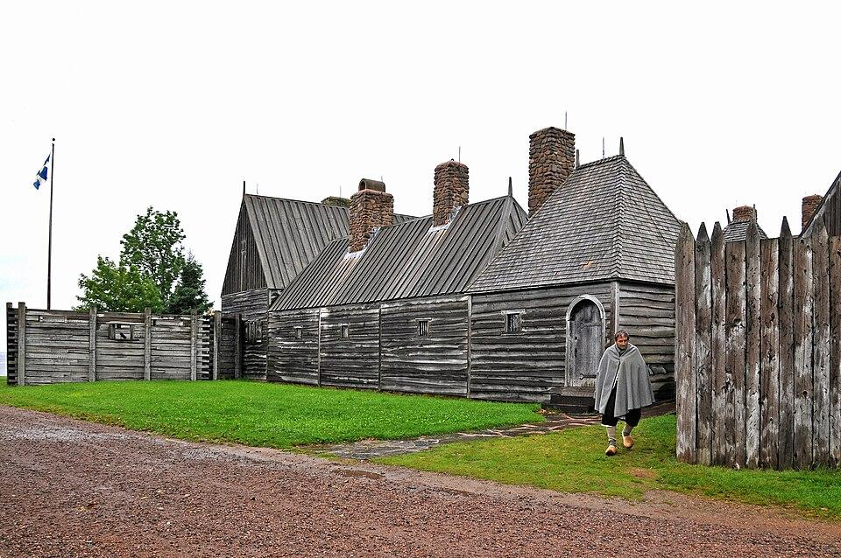
Economic Background
The majority of people were part of the peasant class and were the most vulnerable when France experienced difficulty.
Causes of economic struggles:
Cool temperatures
War
Colonies in the Americas
Palace of Versailles.
Notes:
Out of the 19 million French, 15 million were part of the peasant class.
There was a mini-ice age due to a volcanic eruption sending ash into the atmosphere. The cool temperatures caused problems with crops so the food supply is sporadic
France was involved in two wars, the Thirty Years’ War (1618-1648) and the French-Spanish war (1635-1659). War cost money and interrupted trade.
France’s colonial history in the Americas began in 1605 with Nova Scotia and expanded into Louisiana in 1699 (Louisiana is named after Louis XIV).
In 1661, Louis started renovations to build Versailles, he moved the government there in 1682 but continued to build on to it until his death in 1715. He spent over $100 million Livres on Versailles over the course of 50 years.
To compare, in the peasant class a man might earn ten sols a day, a woman might earn 5 sols a day, and children about 2. The family might earn 100 to 200 livres a year.

Slide 17
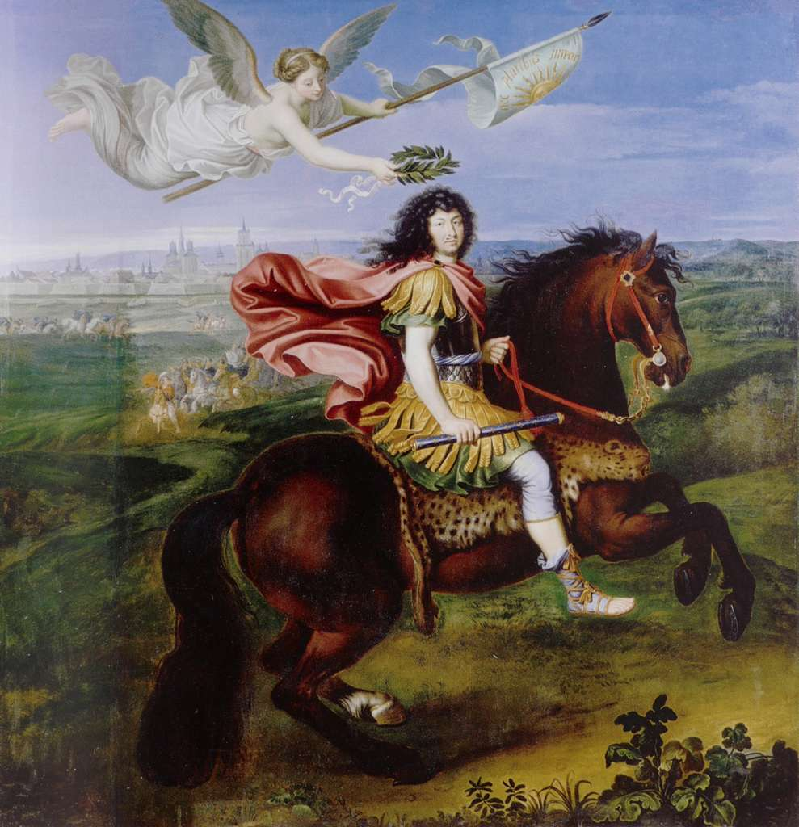
L o u i s X I V
Louis XIV ruled from 1643-1715.
The “Sun King” believed he was king by divine rite and ruled by absolute monarchy.
To maintain absolute rule, he needed a strong social hierarchy system with support of the nobility.
Notes:
He was the longest ruling French monarch at 72 years. He was born in 1638 and became the King of France before he was 5.
Louis parents, Louis XIII and Anne of Austria, had multiple still births before they finally had Louis XIV, they often talked about how his birth was miraculous and are a big part of the reason Louis believed it was God’s will he was king.
Part of the reason why Louis was involved in so many wars is because war could make money for the nobility and he built Versailles so he could require the nobles with influence to move in and he could keep an eye on them. They all lived off of the taxes of the peasant class. It would have been to Louis advantage to keep a rigid social structure to keep everyone in their place.
Louis was about 5’4’’ and wore high heels and big wigs that made him appear taller. This was part of French fashion but he also had most of his portraits painted of him on stairs or on horseback. He was also very proud of his good looking legs.

Slide 18

Education Background
Primary school options:
Private tutors
Little schools
Charity schools or Covenant schools
There were a couple of schooling options available but there were no laws requiring students attend every day or even at all.
Almost 80% of France was illiterate.
Secondary school options:
College
Specialty Guilds
Higher education:
University
Notes:
These were the schooling options for kids up to about 9 years old.
Private tutors: A writing master would come to their house and give one-on-on lessons to prepare students for higher education. This education was very expensive and therefore only available to the nobility and upper bourgeoisie. They were provided an education in writing, math, and Latin.
Little schools: Children of modest means would pay modest fees for an education from a writing master. They were provided an education in writing, math, and Latin.
Charity and Covenant Schools: Were free and only available to students who were registered with their parish as poor or orphaned. They were taught by Priests or nuns and free to students. The education focused first on teaching Catechism and Christian doctrine then on reading, writing, and arithmetic.
Secondary school options:
Most but not all colleges were connected to Universities and were the ways to prepare students for higher education. A student must pay for college.
Specialty guilds were like vocational schools. They were taught by guild masters and the only way to be licensed as a master in a field. A student would pay the guild master or would work for the guild master for free as the form of payment.
Higher Education options:
University charged tuition and usually only a small percentage of bourgeois would attend. It was for those who wanted a position in the Church, Law, Medicine or an administrative role in government.
The education system was not set up to teach a lot of students and usually required money. Even schools that did not charge tuition would have costs that prevented the poor from attending, students would have to pay for exams and supplies like candles, pens, ink, and paper. Even if the families could manage to pay for supplies, it would be a sacrifice to send the child to school instead of to work where they could contribute to the family income. With these things in mind, it is no surprise that most of France could not read and write. The education system was built to support the social hierarchy.
(De La Salle’s schools were different in that they continued the primary education into advanced studies for poor boys beyond the age of nine, they were completely free and did not require fees for supplies, and teachers were trained to provide both a catechetical education and a secular education.)

